Slide 1
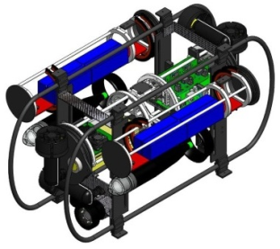
Menu
Final project/competition
Presentation and PowerPoint
  Latest MIL show
MIL/CIMAR videos (and field trip)
  SubjuGator Video
    Intro: 2015: https://youtu.be/Qd421tnoLU0 2014: https://www.youtube.com/watch?v=cmNSC6u0mEE
    See also https://www.youtube.com/user/SubjuGatorUF
  PropaGator Video
    Intro: 2015: https://youtu.be/oSh3_Yc25Y4 2014: http://youtu.be/TBPfQktjnd4
    Recent: http://www.youtube.com/playlist?list=PLDwP3qsTjWS8vqXkVOfxYCKqd69EcWP-p
    See also http://propagator.org/?page_id=2600
  Urban Grand Challenge Videos
  Others?
  Go to MIL and CIMAR
See examples on
web-site: 06_Project.pptx
Notes:
2

Slide 2
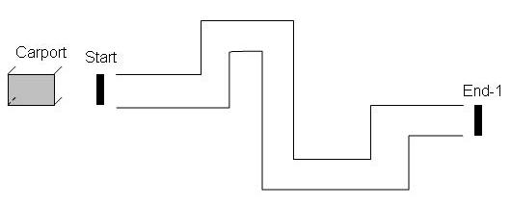
Competition Description
Walled-path with start and end lines
  See next page for more course info
Walls will be 2x6’s
The object of this competition
  Go through the path from the starting line to the end line
  Turn around at the end line and then come back to the start line
  Continue past the start line and stop in the “carport.”
    The carport will have a roof, but may have no walls.
  PowerPoint presentation to class is part of competition
  Time is important
  Bonus points will be added for effects and elegance of solution
    Sound, smooth motion, etc.
Start
Start
(IR beam)
Turn Line

Slide 3
Final Competition Layout
Robot must wait on starting line for IR “GO” signal, indicated by a flash light.
Team must tell story about where there robot is going and why.
Robot must fully cross destination line, then turn around.
The robot must return to the garage, stop, and beep. (The time elapsed from the GO to the beep will be stated by the TA for the video recording.)
Example course
Robot must
fully cross
this line
Dark
Garage
Flash Light Start

Slide 4
Teams and Schedule
You will be in the same teams you have used also semester (3 or 4 students)
Each team will have the opportunity to make 2 videos
  The videos will be posted on our website
Each team will make a give a PowerPoint presentation on Tuesday, 19 April, during our LAST class (i.e., there will be *NO* CLASS OR LAB on Tues, 12 Apr)
  One of the two videos of the robot in action should be part of the presentation
    Email Dr. Schwartz about which video you want to present
      Dr. Schwartz will put that video file on the presentation computer desktop
      Email your presentation to Dr. Schwartz by 2pm on Monday,
      18 Apr, to EGN1935@gmail.com

Slide 5
Presentation Content: Title Page
Title Page
  Course Number and Name (EGN 1935: ECE Adventures)
  Team name, Robot name
  Team members names
  Semester and year (e.g., Fall 2037 or Spring 2042)
  Example title page on next page

Slide 6
Team: TermaGator Crew
Robot: TermaGator 37
Spring 2016
Team Members
Candy Kane
Joe Mama
Clem Cadidalhopper

Slide 7
Presentation Content: Summary
Summarize the content of your presentation
For example:
  Member biographies
  Robot Story
  Team conclusions

Slide 8
Presentation Content: Biographies
Bio of each team member (at least one page per)
  Year (freshman, sophomore, etc.)
  Major
    If major changed during this semester, old major/new major
  What you gained/learned in this course
  How will this course affect you in the future
  UF plans and goals
  Career plans and goals
  Words of wisdom to pass on to the next group of students (or your brother/sister)
  Example bio on next page

Slide 9
Bio of Joe Mama
2nd semester Freshman
Before this semester I was going to be a Professional Wrestling major
After taking this course, my major is now EE (but I’m also consider CE and ME)
This class has shown me that engineering can be fun! I’ve learned to use several pieces of equipment including multimeters and oscilloscopes
  I now have a basic understanding of circuits, signals, sound, sensors and motors
I will definitely get involved in some projects while at UF

Slide 10
Bio of Joe Mama (continued)
I want to make the first wall climbing robot at UF.
I want to start my own company (Joe Mama Inc.) after working at a big company for 2-3 years. I want to invent something cool!
UF classes can be fun if you find the right ones (like this one). Go to sports events, do intramurals or clubs and get involved in competition teams.

Slide 11
Presentation Content:
Robot Story
Have your team come up with a story about your robot’s travel through the maze

Slide 12
Presentation Content:
Team Conclusions
Have your team come up with a single statement of what you have gained/learned in this course and words of wisdom to pass on to the next group of students (or your brothers/sisters)

Slide 13
Presentation
Use PowerPoint (see 06_Project.pptx on website)
  If you have your own laptop, you can use a different presentation program
Presentation length is 4-6 minutes (including video)
  No more than 6 minutes (including your video), please!
All team members should contribute to the presentation creation and all members should speak
We will video tape the presentations and post them on the web
  Dress up for the presentation
    Date clothes or better
    No shorts, t-shirts or flip-flops
06_Project.pptx

Slide 14
PowerPoint Presentation
Use a dark background with light fonts or a light background with dark fonts
  The former is generally better than the latter
  Be sure that all fonts can be easily seen
All fonts should be at least 20 pt, but this is a minimum. For example: This is 32pt
  This is 28pt
    This is 24pt
      This is 20pt
Do NOT put too much info on a single slide

Slide 15
PowerPoint Presentation (Continued)
Only the important points should appear on the visual aids
  The speaker fills in details orally
Use figures, diagrams, photographs, graphs and tables
  Figures are better words
Avoid detailed, complex figures
Demonstrations or videos enliven a presentation
Practice your presentation before the event

Slide 16
Video
Each of the two robot video that are taken in lab should start with the below statement:
  The is EGN 1935: ECE Adventures in Spring 2016 with Dr. Arroyo and Dr. Schwartz. Our TA is [Mason Turner or Khaled Hassan].
  Our team’s name is: _________
  Our robot’s name is: _________
  My name is: _________
  My name is: _________
  My name is: _________
After the statement, give a running commentary about what the robot is doing
Add concluding remarks

Slide 17



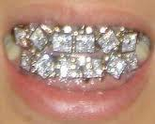
All About the Bling
“Scholarship” (prizes) WILL be awarded

