Slide 1
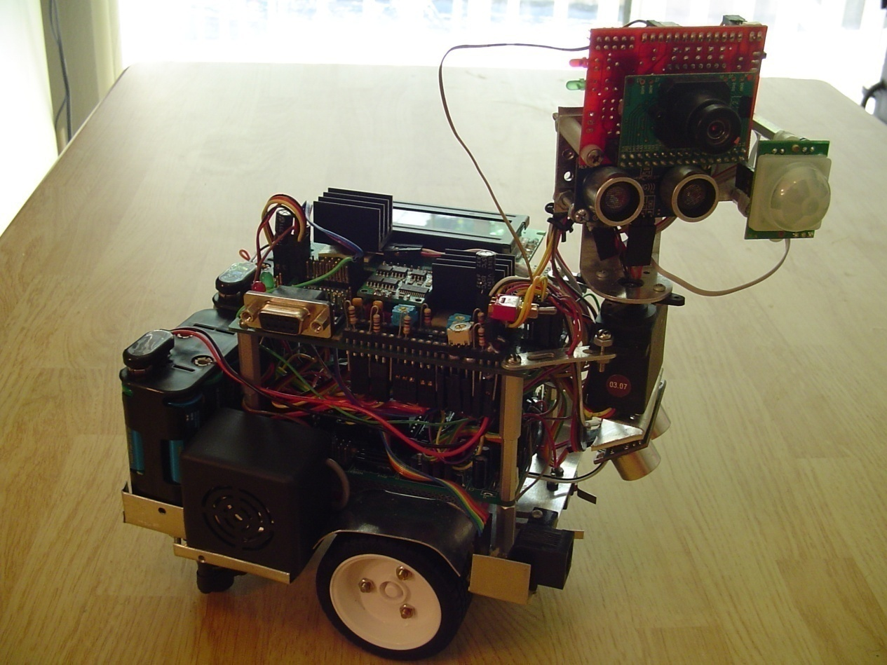
R2-D3
ButlerBot Edition v1.0

Slide 2
Functionality
Execute commands given by user
Detect user presence
Follow color worn by user
Avoid obstacles in the immediate environment

Slide 3
FUNCTIonality – detail
R2-D3 is always in one of the following modes:
COMMAND MODE
COLOR-TRACKING MODE
MOTION-DETECTION MODE
OBSTACLE-AVOIDANCE MODE

Slide 4
Command mode
Follow “command color”
Detect a pattern in command code movement
Commands:
Left-to-right: About-me
Right-to-left: Human Detection
Up-down: Go to Motion Sensing Mode
Down-up: Go to Obstacle Avoidance Mode

Slide 5
COMMAND MODE

Slide 6
COLOR-tracking mode
Follow tracking color with head
Chase tracking color
If color is lost move towards the side (left/right) with the last knows set of coordinates
Turn 360 in same direction until color is found
Wait some “buffer” time until tracking color is lost

Slide 7
Tracking color mode

Slide 8
Motion-detection mode
Poll forward and aft motion detectors
Decide if the person is in front or behind the robot (probabilistically)
Move towards the person

Slide 9
Motion-detection mode

Slide 10
Obstacle-avoidance mode
Poll the distance to an obstacle at five angles (0-180)
Decide which path is the most open
Move a distance of open_distance/2
During movement poll distance and ground sonar
Shown working in class and “command mode” video

