Slide 1
Gator Raider
Autonomous Tank Robot by Raymond Bolen

Slide 2
Attributes
Top-mounted coil gun
Ackerman steering
Single motor with differential
3 ultra-sonic sensors
Webcam
Raspberry Pi and Arduino controlled

Slide 3
Behaviors
Navigates a closed course of cardboard walls
Identifies balloons taped to walls
Targets and shoots balloons
Reloads and repeats

Slide 4
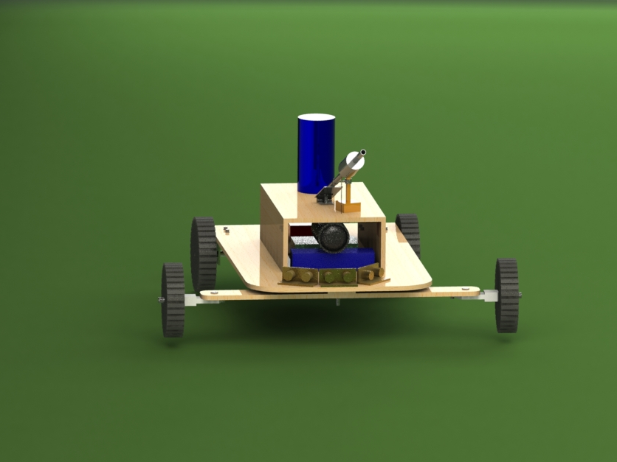

Slide 5
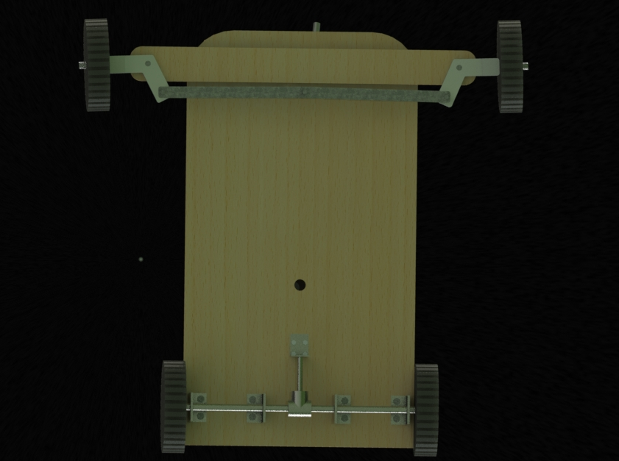

Slide 6
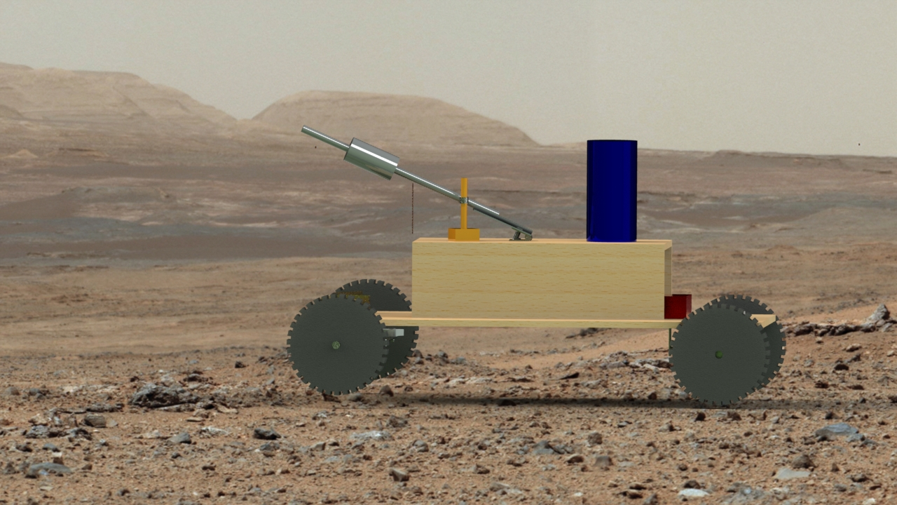

Slide 7
