Slide 1
Give & Go-bots
Brandon Peterson
January 28, 2016

Slide 2
Summary
Project overview
Individual robot specs
What’s left to finalize?
Feedback

Slide 3
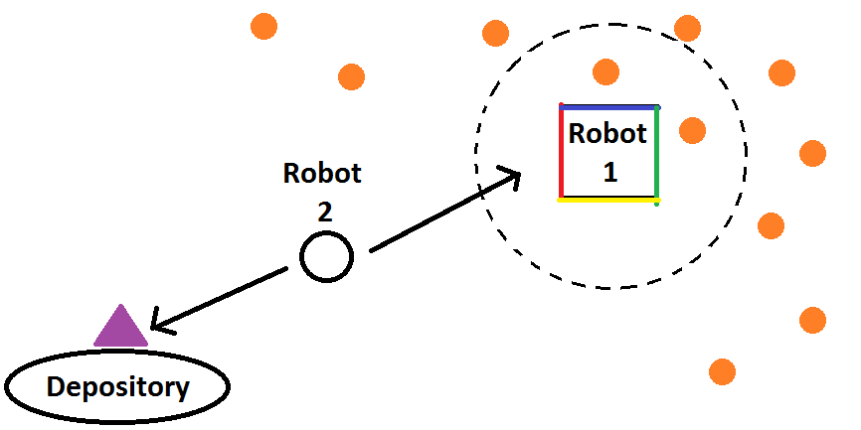
Project Overview
Team of two robots working together to complete a find and retrieve mission
Goal: Improve speed/efficiency of single-robot, find and retrieve system

Slide 4
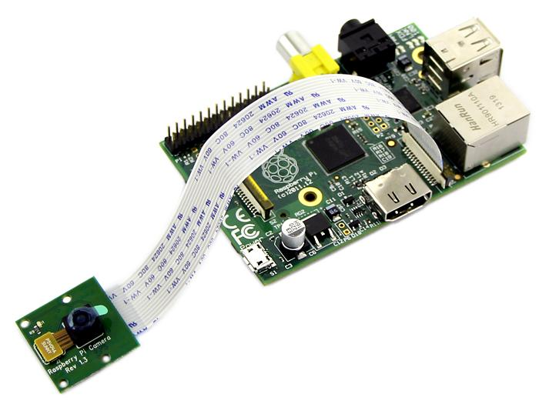
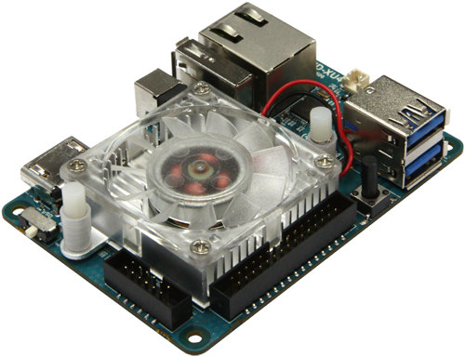
Individual Robot Specs
Robot 1
OpenCV on Raspberry Pi 2 w/ Pi Camera Module
Xbee + LCD (feedback)
IR rangefinder
Arduino
Robot 2
OpenCV on Odroid XU4 w/ PS3 Eye
Xbee + LCD (feedback)
IR rangefinder + bump switch
Arduino

Slide 5
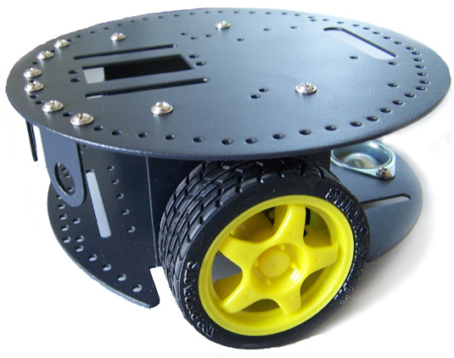
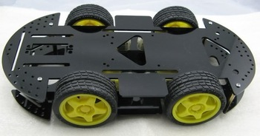
What’s Left to Finalize?
Arm Design
Two dof may make dropping in bucket easier
Platform Designs/Wheels
Robot 1: two layers, four wheels
Robot 2 (smaller): two or three layers, 2 wheels + castor

Slide 6
Feedback
Questions?
Comments?
Concerns?
Complaints?

