Slide 1
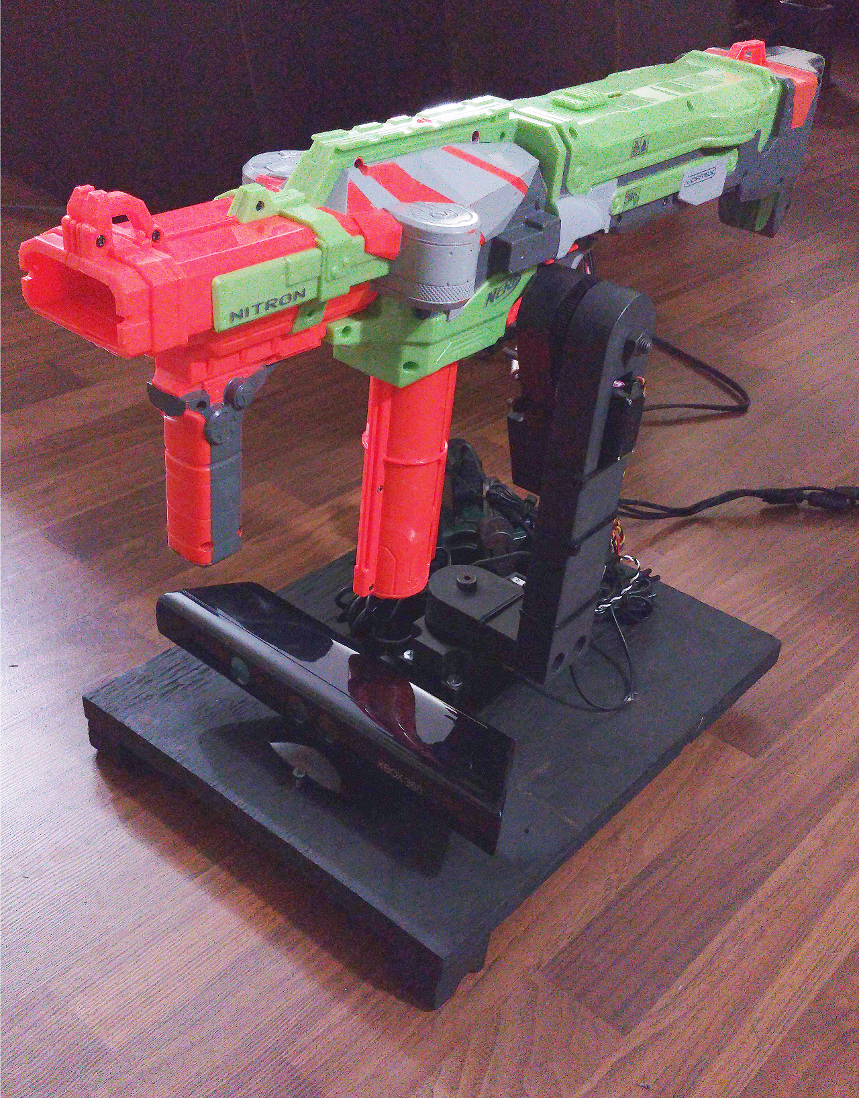
Autonomous Sentry Gun
David Campbell
January 27th 2016

Slide 2
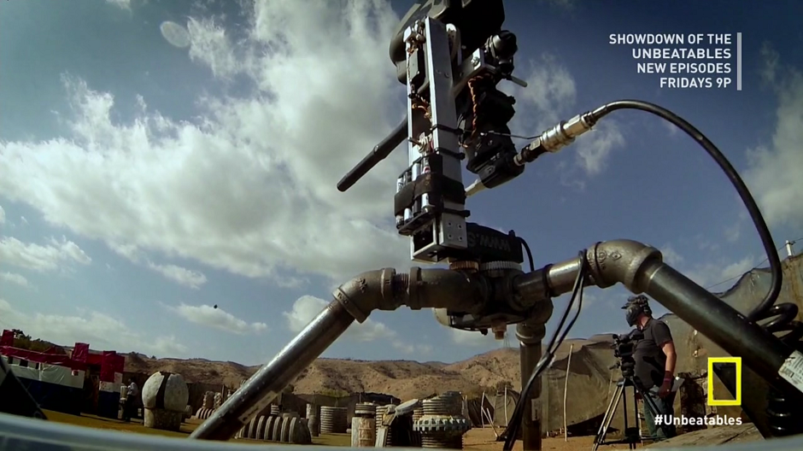
Summary:
Tracking and engaging an object autonomously has many applications:
  Law Enforcement & Military training
  Autonomous Hi-detail security camera systems
  Scenario Paintball/Airsoft/Laser-Tag
I hope to improve the system’s performance with the added depth data
My approach to the problem is adding depth data to the current targeting system
What I have done so far is to replace the webcam with a Kinect and have spent several days working on the code
The results so far have been good and I plan to continue working on the code to improve the system further

Slide 3
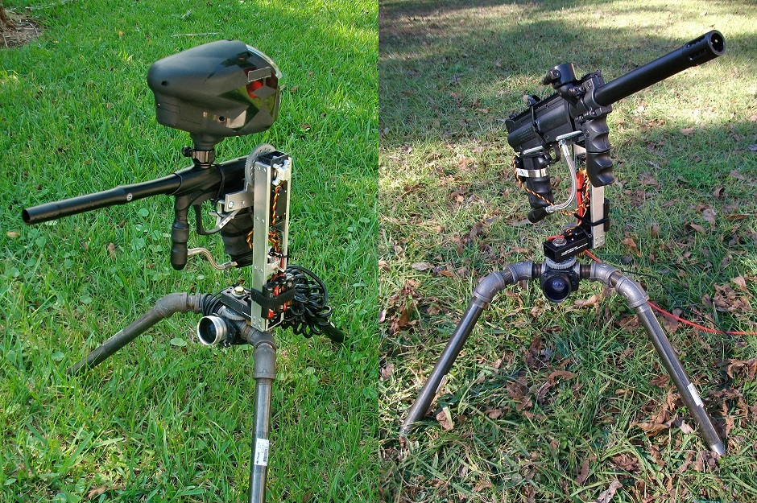
Introduction
Sentry guns were a favorite video game weapon of mine
I started trying to build them in 2008
Getting it to perform like a human player was very challenging
Most of the work will be in the software
The problem will be in correctly handing the depth data in such a way that it provides meaningful and significant improvements to false target filtering and target anticipation

Slide 4
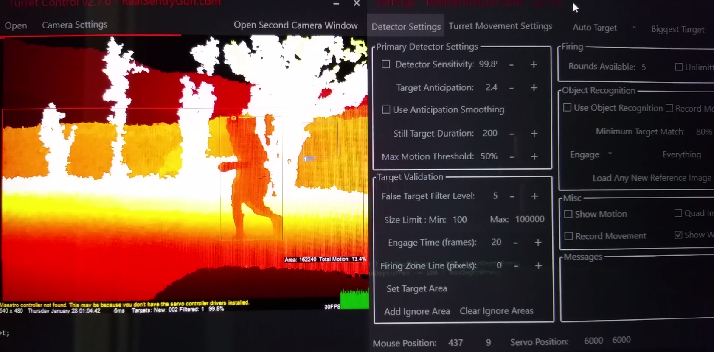
Body of Talk
The challenge will be mostly in software
Even with depth data, there are still issues such as how to handle noise and zero depth data
Target anticipation with depth will not be as simple as the math suggests

Slide 5
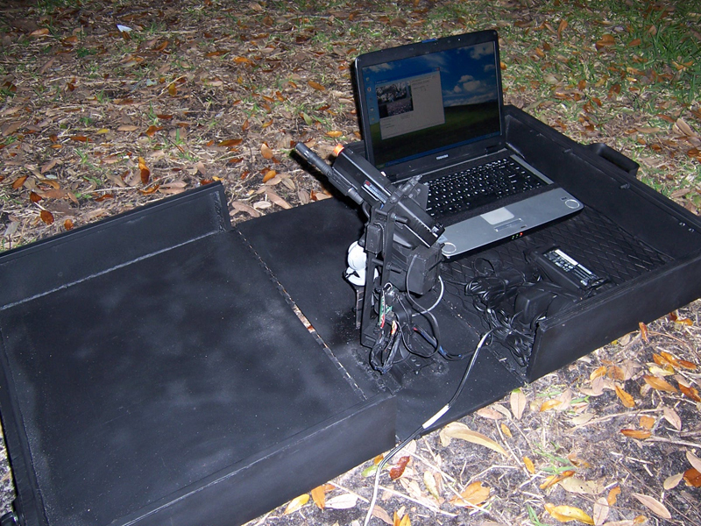
Conclusion
So far the Kinect is working but there is much to do in the software
The hardware works but could be improved
The new target anticipation algorithm has not been implemented yet
Several bugs need to be fixed

Slide 6
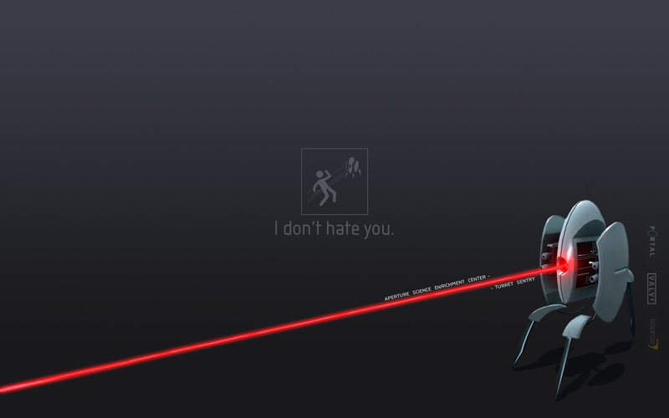
Future Work
3D printed design
Two Kinects for a wider FOV
Kinect V2
24GHz Doppler radar (from adaptive cruise control systems)
LIDAR

