Slide 1
EVIBOT THE EARTH VEGETATION IRRIGATOR rOBOT
Maria Carrasquilla TAs: Andy Gray, Jake Easterling and Ralph F. Leyva Instructors: Dr. A. Antonio Arroyo and Dr. Eric M. Schwartz
University of Florida Department of Electrical and Computer Engineering EEL4665/5666 Intelligent Machines Design Laboratory
28 January 2016

Slide 2
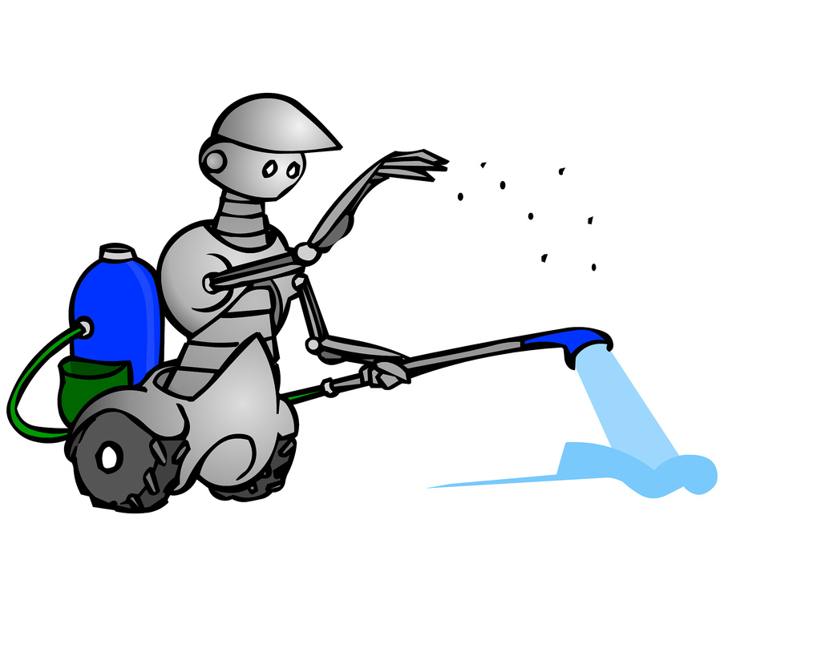
introduction
Problem: Plants need water, but what if there’s no one to water them?
Solution: EVIbot
Objective Automate plant watering process
Tasks 1. Identify plant (marked pot) 2. Drive up to the pot 3. Determine if the plant needs water a. Water plant 4. Move to next plant or stop task

Slide 3
Integrated system
Soil Sensor

Slide 4
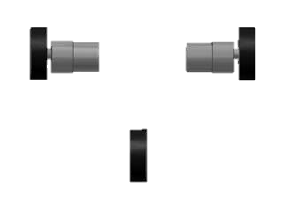
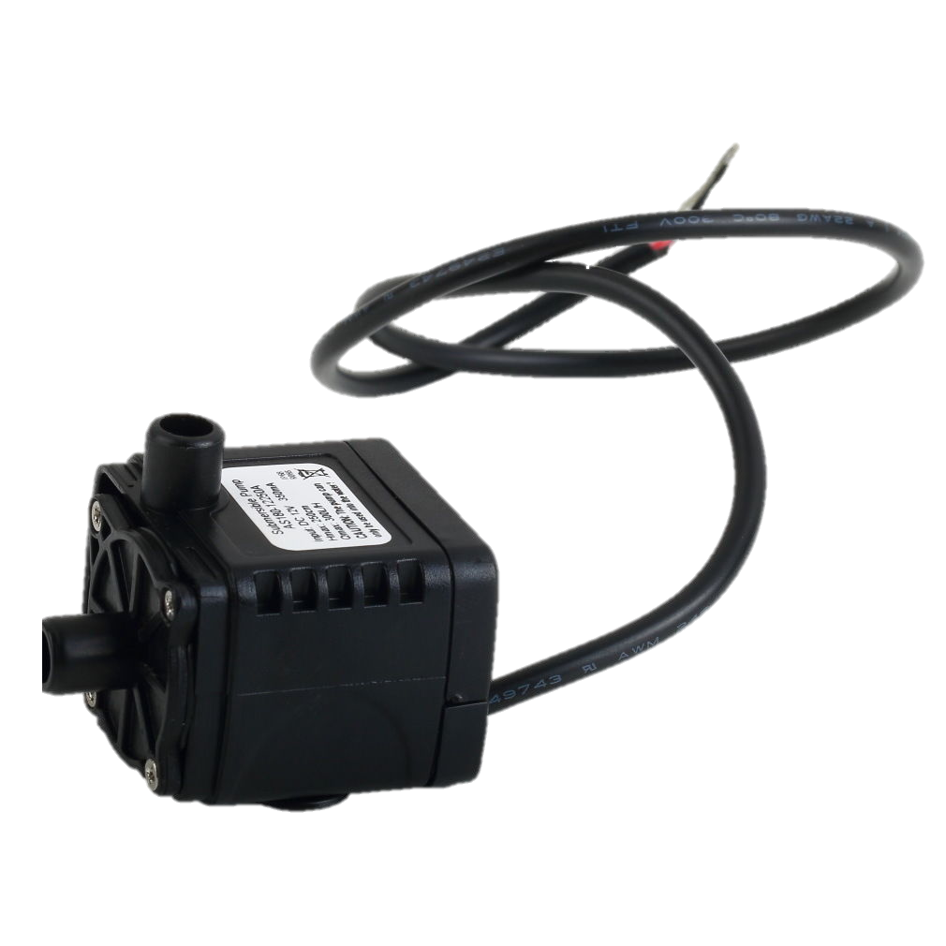
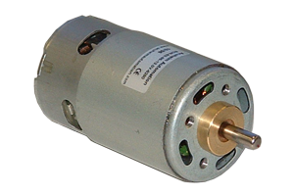
Mechanical Hardware
3-Wheel mobile platform
2-tiered platform
Electronics housed in the middle
2 DC motors for drive wheels
1 Water pump
Plastic container and hose
3-wheel platform

Slide 5
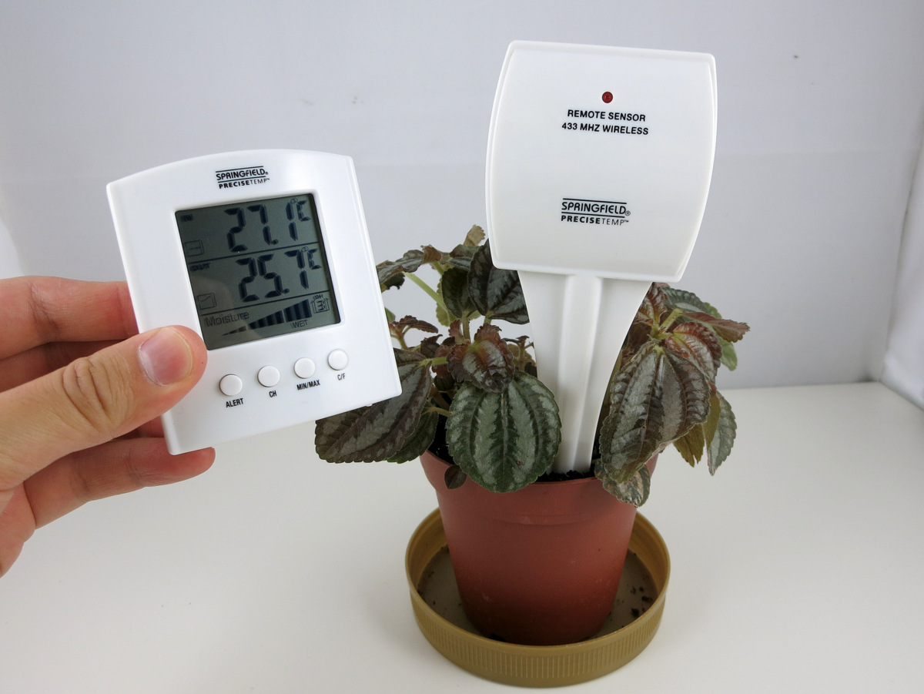
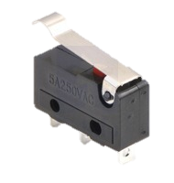
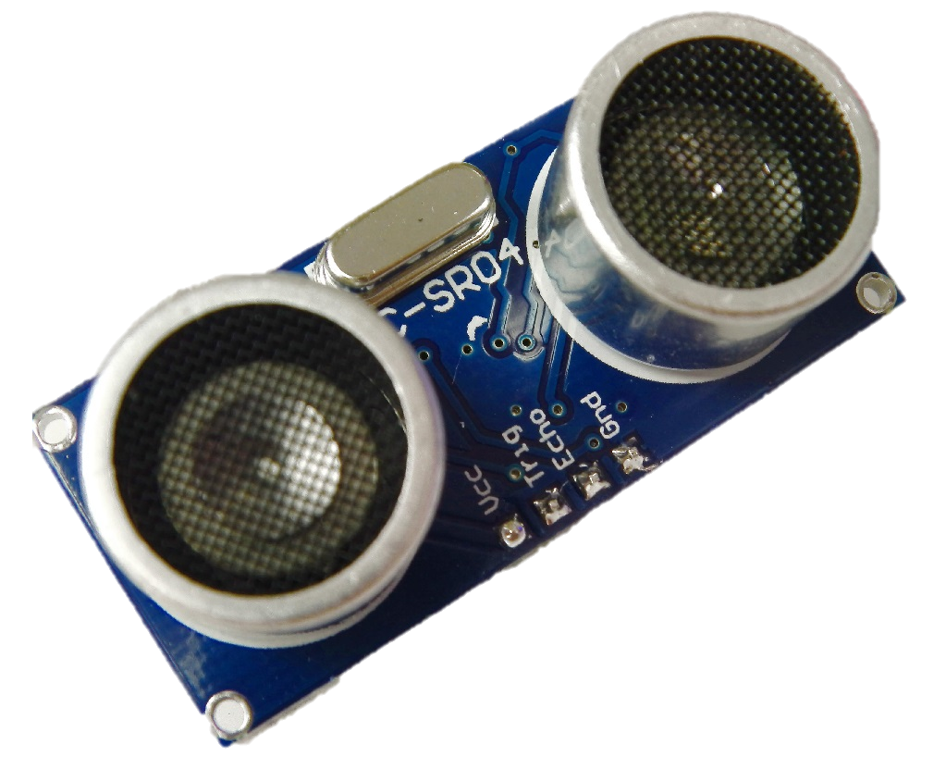
sensors
RF receiver
2 Ultrasonic sensors
2 Bump switches w/ whiskers
Soil moisture sensor (external)

Slide 6
QUESTIONS?

