Slide 1
DAN Robot
William Case
Report 1

Slide 2
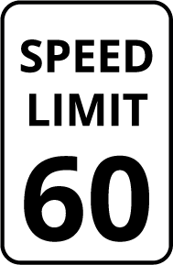
Behaviors
Navigate a course following the shortest path
Dynamically adjust planned path based on new information
Detect and respond to signs along the path

Slide 3
Integrated System

Slide 4
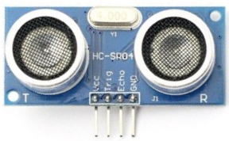
Sensors
Ultrasonic Distance Sensors
IR Reflectance Sensors
Camera

Slide 5
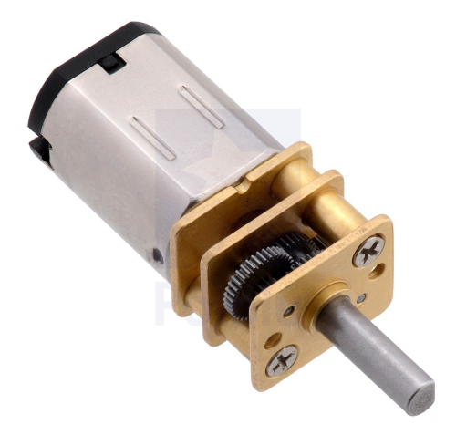
Actuation
DC Motors

Slide 6
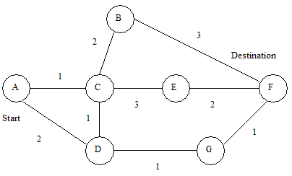
Course
Multiple intersecting lines
Internally mapped as a multi-dimensional array

Slide 7
END: rjmp END

