Slide 1
Dancing Robot
Student Name: Huizhong Cheng
Instructors: Dr. A. Antonio Arroyo, Dr. Eric M. Schwartz
TAs: TAs: Andy Gray, Jake Easterling, Ralph F. Leyva

Slide 2
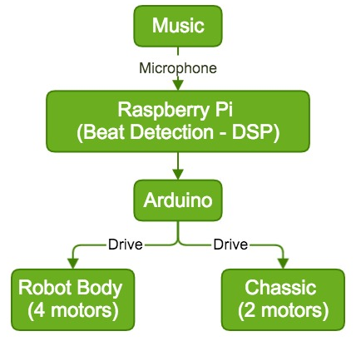
System Structure

Slide 3
Function and Hardware
Movement
Tilt (backward-forward)
Tilt (left-right)
vertical-shrink
horizontal-rotate
Various Combination
Obstacle Avoidance
Hardware
Raspberry pi 2 model B
Arduino UNO
Microphone
Ultrasonic Ranging Module
4 Servo motors for body
2 Gear motor for bottom platform
Arduino Motor Shield

Slide 4
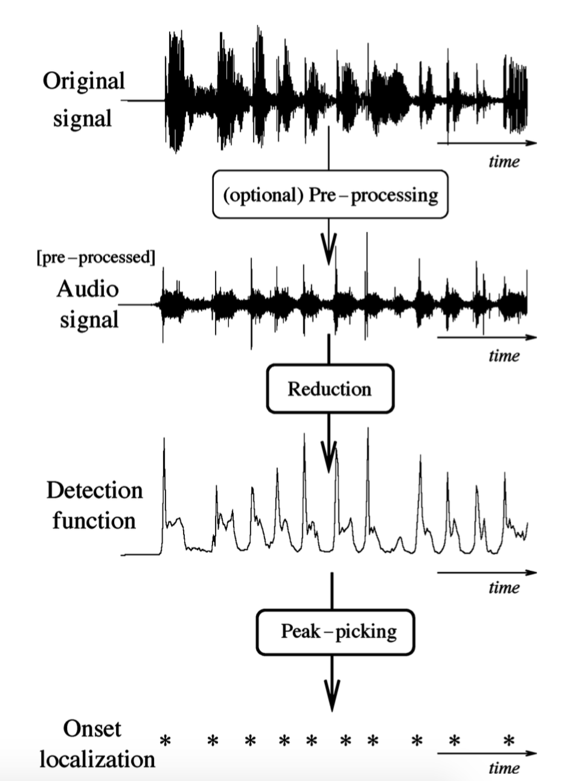
DSP Flow Chart
FFT
Accentuate low frequency
Attenuate high frequency
Pre-Process
Energy envelope
Adaptive Thresholding
Decision process

