Slide 1
TEMRo
Target Eliminating Medivac Robot
Alexander Cornejo
Oral Report 1
Date: 1/28/16

Slide 2
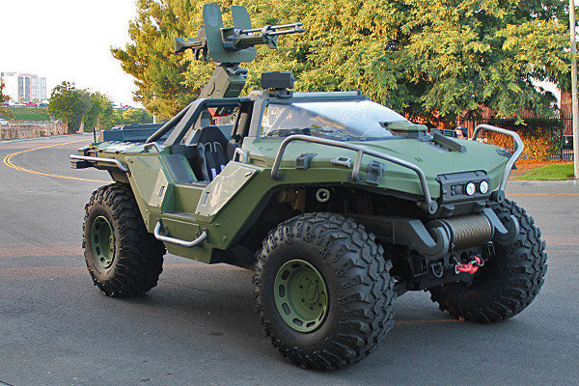
Introduction
Mission:
  Identify home base and navigate to it
  Will protect “passengers” with laser turret

Slide 3
Behaviors
Avoid obstacles while tracking home base identifier
Once in view of targets switch to seek and “destroy mode”
  Turret on pan/tilt
  Fires laser
After targets are “eliminated”, it will complete journey home

Slide 4
System Overview
Camera
Module
RASPBERRY PI 2
Ultrasonic Sensors
Laser Pointer
ARDUINO UNO
Pan/Tilt
2 Servos
Bump Switches
DC Motor Right
Motor Driver
DC Motor Left

Slide 5
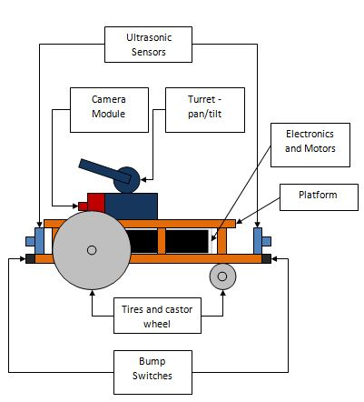
Design Sketch

Slide 6
Questions?

