Slide 1
The CATastrophe
by Christian Cousin
Ph.D. Mechanical Engineering
IMDL 2016
TAs: Andy Gray, Jake Easterling, Ralph Leyva
Instructors: Dr. Antonio Arroyo, Dr. Eric Schwartz

Slide 2
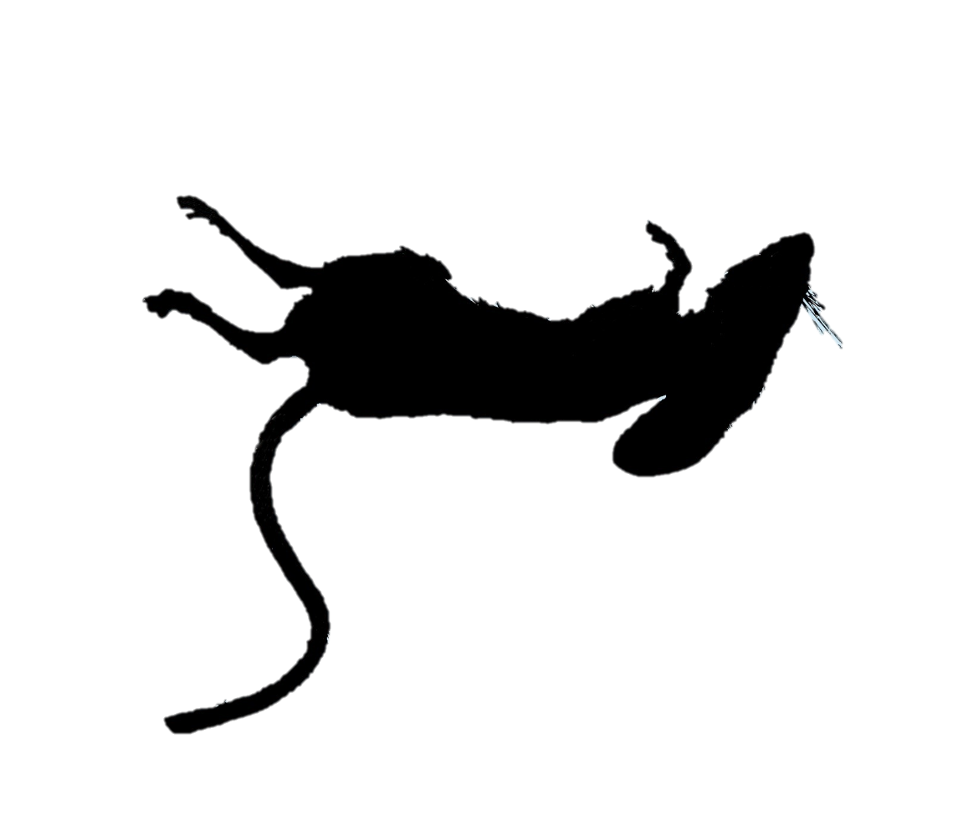
The CATastrophe
MISSION
Search + Destroy
Robotic Mice
Notes:
What is the catastrophe? Its an autonomous search and destroy robot that uses vision to track and eliminate its robotic prey.

Slide 3
The CATastrophe
PLAN OF ATTACK
Stage 1: Prowl – Slowly patrols with basic obstacle avoidance
Stage 2: Hunt – Detects prey and pounces into action
Stage 3: Capture – Ensnares mouse and zaps with
electromagnet
Notes:
Simply put, the catastrophe has two modes: prowl and hunt. Prowl is active when it doesn’t detect any prey and it will patrol the arena looking for prey. As soon as it detects prey, it will give chase and seek to catch and disable it.

Slide 4
The CATastrophe
BEHAVIORS
Prowl: Arduino Mega, IR x 2, Sonar x 2, Whiskers
Hunt: Raspberry Pi, Pi Cam
Capture: Mechanical Snare, Electromagnet
Opt 1: Snare with electromagnet on arm
Opt 2: Corral and snare with electromagnet
Opt 3: Conveyor belt into cat and deactivate with electromagnet
Notes:
The catastrophe will consist of three main behaviors: first, a basic obstacle avoidance system utilizing IR sensors, sonar, and whiskers with an arduino; secondly, a hunt and track system which will use a Raspberry Pi and camera to lock on and chase mice; finally, it will have a method of disabling the mice, consisting of an electromagnet and some contraption to be decided to ensnare the mouse.

Slide 5
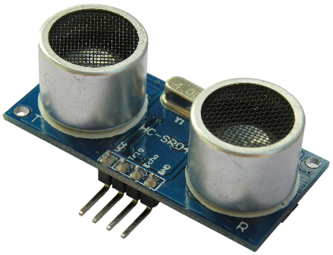
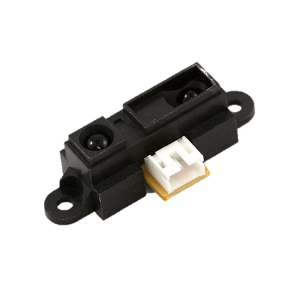
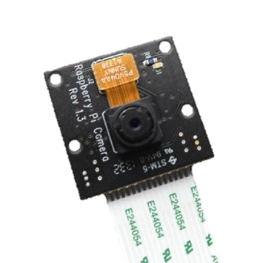
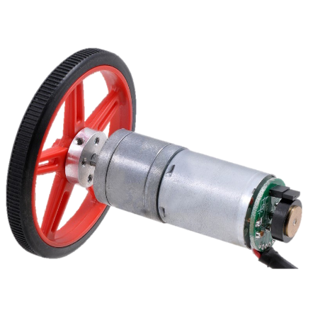
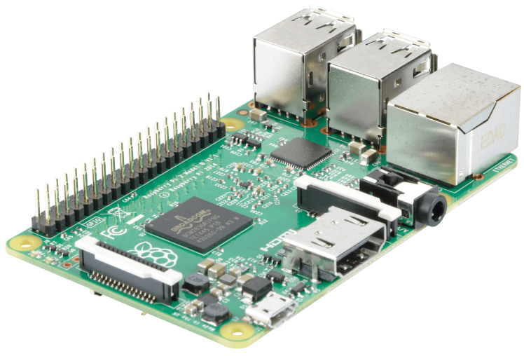
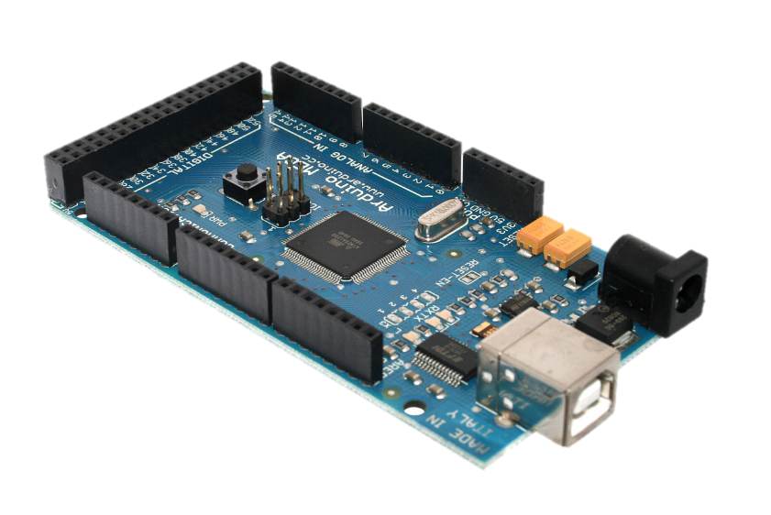
The CATastrophe
SYSTEM HARDWARE
Snare
+
Electromagnet
Notes:
As stated, the predator will consist of an Arduino Mega, Raspberry Pi, a variety of sensors, and a snare and electromagnet which are under development

Slide 6
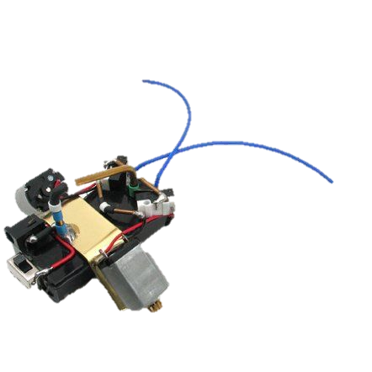
The CATastrophe
THE PREY
Notes:
The prey will be two DC motors connected to AA batteries, along with bump switches that effectively create an H-bridge and allow for the brief reversal of motors upon hitting obstacles.

Slide 7
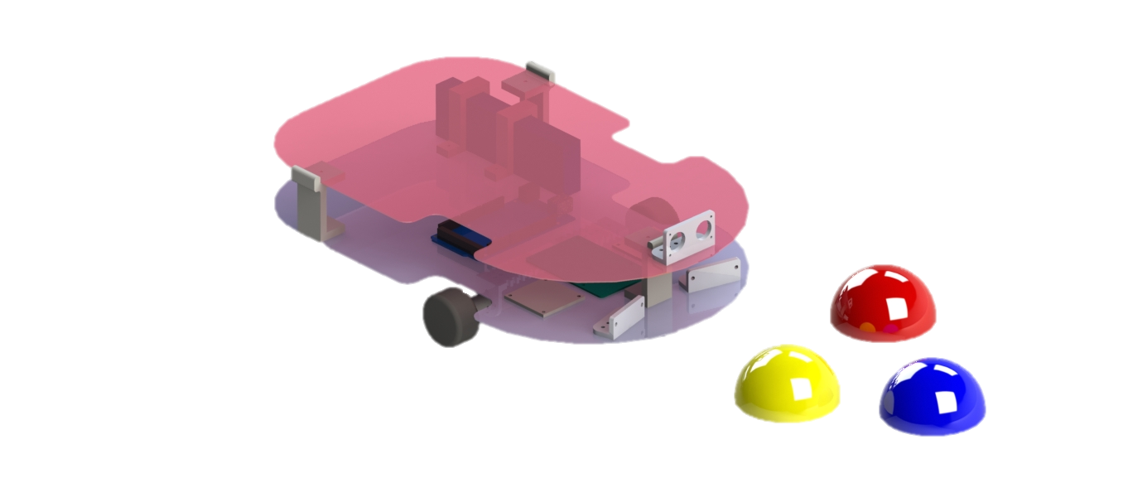
The CATastrophe
THE PREDATOR
Notes:
Here is a preliminary look at what I envision the catastrophe to look like, along with the mice it will hunt

Slide 8
The CATastrophe
PLAYING FIELD
Notes:
The arena will be a rectangle with a few obstacles, with three robotic mice in the enclosure. The catastrophe will lock on to one of its prey and pursue it aiming to catch it, before moving on to the next mouse. Each mouse will be a different color to allow for differentiation.

Slide 9
The CATastrophe
Questions?
Notes:
Thank you, are there any questions?

