Slide 1

Photobot
IMDL Project Spring 2016
Blake Fricker

Slide 2
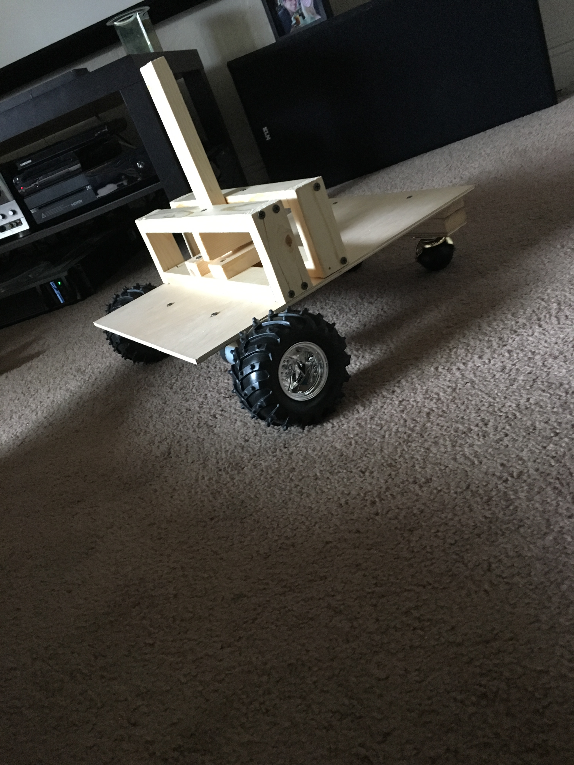
What is it?
Autonomous Rover
Locates and Approaches People
Gives Audible Introduction
Requests Permission
Takes Picture
Prints the Picture

Slide 3
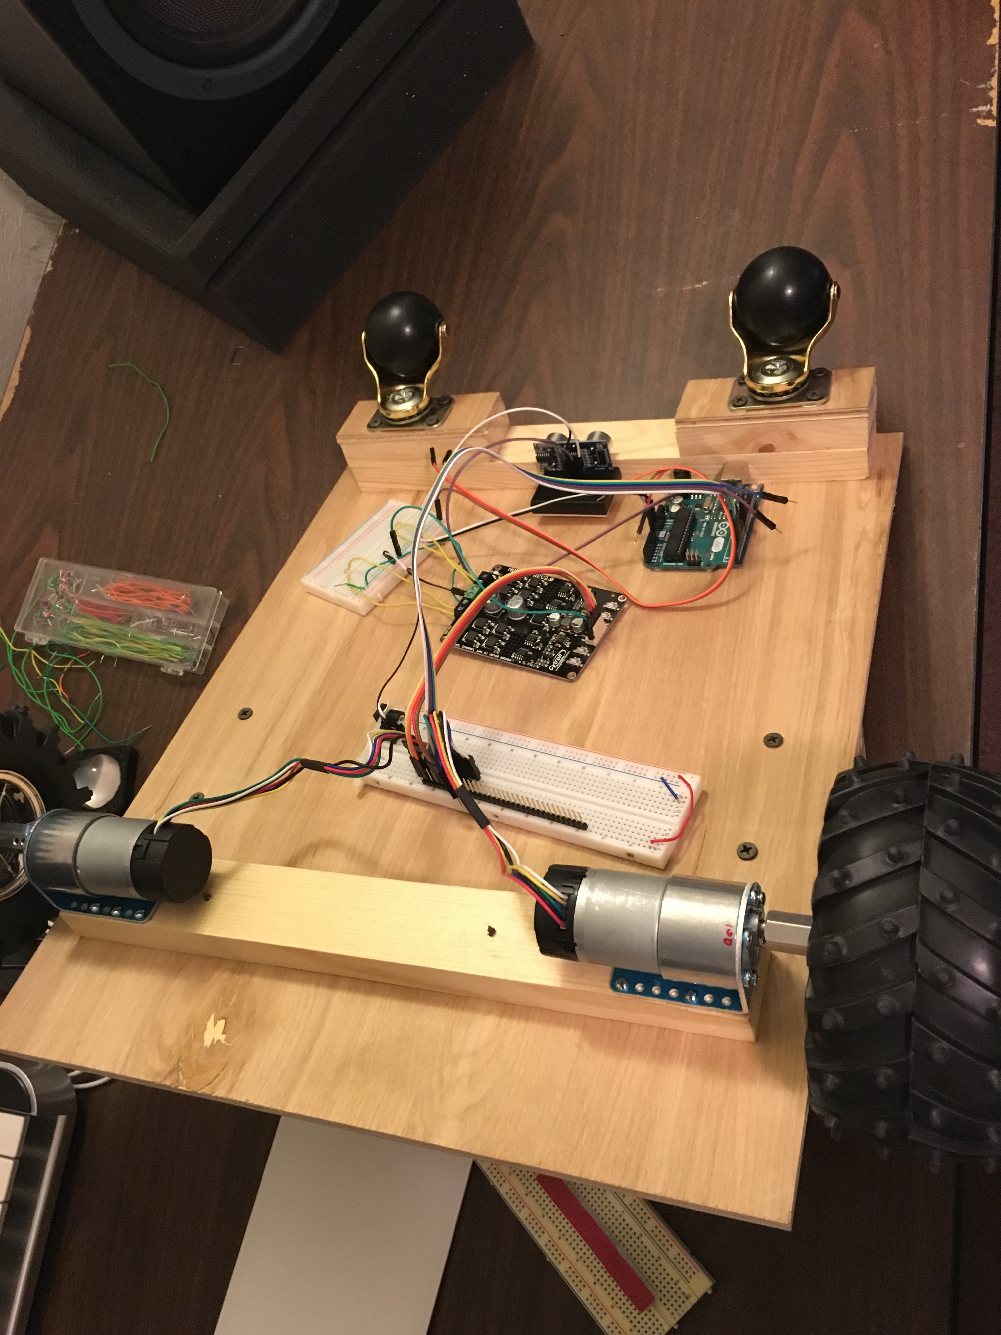
Hardware – Low Level
Arduino Mega
100:1 12V Gearmotor with Shaft Encoder (2) 120x60mm Wheels (2)
Casters (2)
Motor Brackets and Hardware
10A 5-25V Dual Channel DC Motor Driver
HC-SR04 Ultrasonic Range Finder (4)
IR Sensor (2)
Emic 2 Text-to-Speech Module

Slide 4
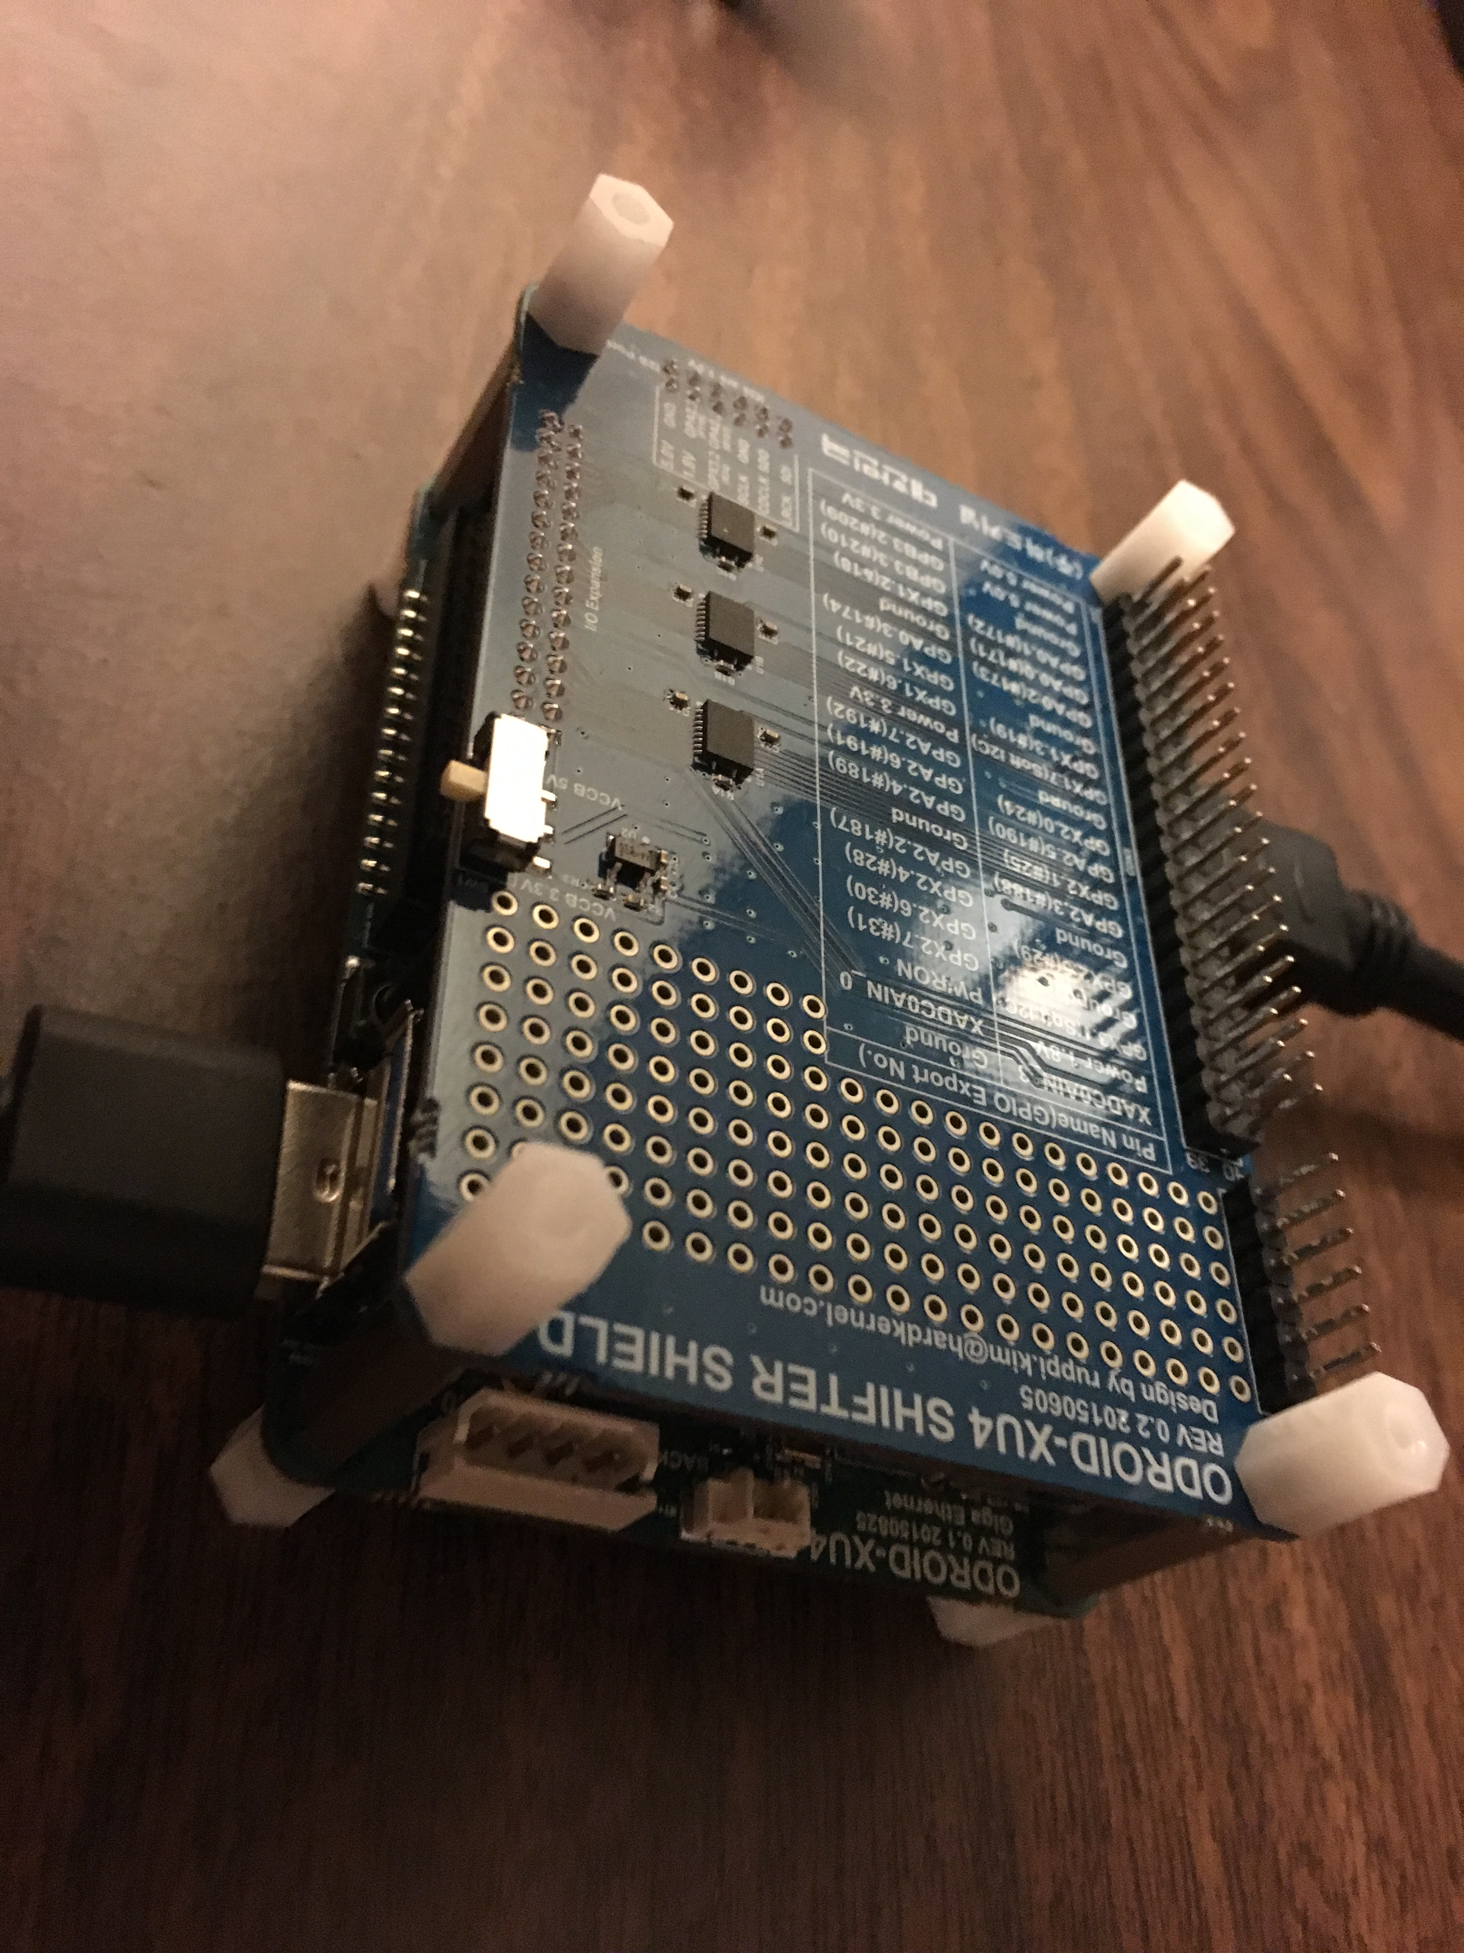
Hardware – High Level
Odroid XU4
eMMc 16GB
Logitech 720p Webcam
USB Wi-Fi Dongle
12.6V Li-Ion Battery
Photosmart A616 printer
  DROK LM2596 Voltage Switching Regulator DC Buck Converter

Slide 5
Questions?

