Slide 1
The Frodo
EEL-5666 Jiyao Guo
TAs: Andy Gray; Jake Easterling; Ralph F. Leyva Instructors: Dr. A. Antonio Arroyo Dr. Eric M. Schwartz

Slide 2
What does it do?
Tracking a human
Sometimes help people carry their lunch box
Self-parking in certain area
Send a warning and stand still when it loses the target

Slide 3
How does it do it?
Human identification:
A big QR code on the back
And also color identification on a walking stick

Slide 4
How does it do it?
Motion control:
a PID controller is used for robot giving order to motors according to the difference between position of object in the camera
the camera can be rotated with three fixed angles

Slide 5
How does it do it?

Slide 6
Self-parking
A LED will be lighted at the top of the walking stick
Robot gets the signal
A QR code will be set at the parking place
Robot looks around and tracks the parking QR code to the parking place

Slide 7
Component
ITEM | NUM | DESCRIPTION | REASON TO CHOOSE
Microcontroller
Arduino Mega 2560 R3 | 1 | Input voltage – 7-12V 54 Digital I/O Pins (14 PWM outputs) 16 Analog Inputs 256k Flash Memory 16Mhz Clock Speed | High speed with plentiful pins.
High Level Development Boards
Odroid XU4 | 1 | Samsung Exynos5422 Cortex™-A15 2Ghz and Cortex™-A7 Octa core CPUs 2GB LPDDR3 RAM PoP stacked eMMC5.0 HS400 Flash Storage 2 x USB 3.0 Host, 1 x USB 2.0 Host | High processing speed for image.
Sensors
USB-Cam 720p | 1 | The main USB camera | Provide high quality video. Work great with Odroid XU4
Mihappy 3pcs Ultrasonic Module | 3 | Ultrasonic sensors | Used to sense the obstacle.

Slide 8
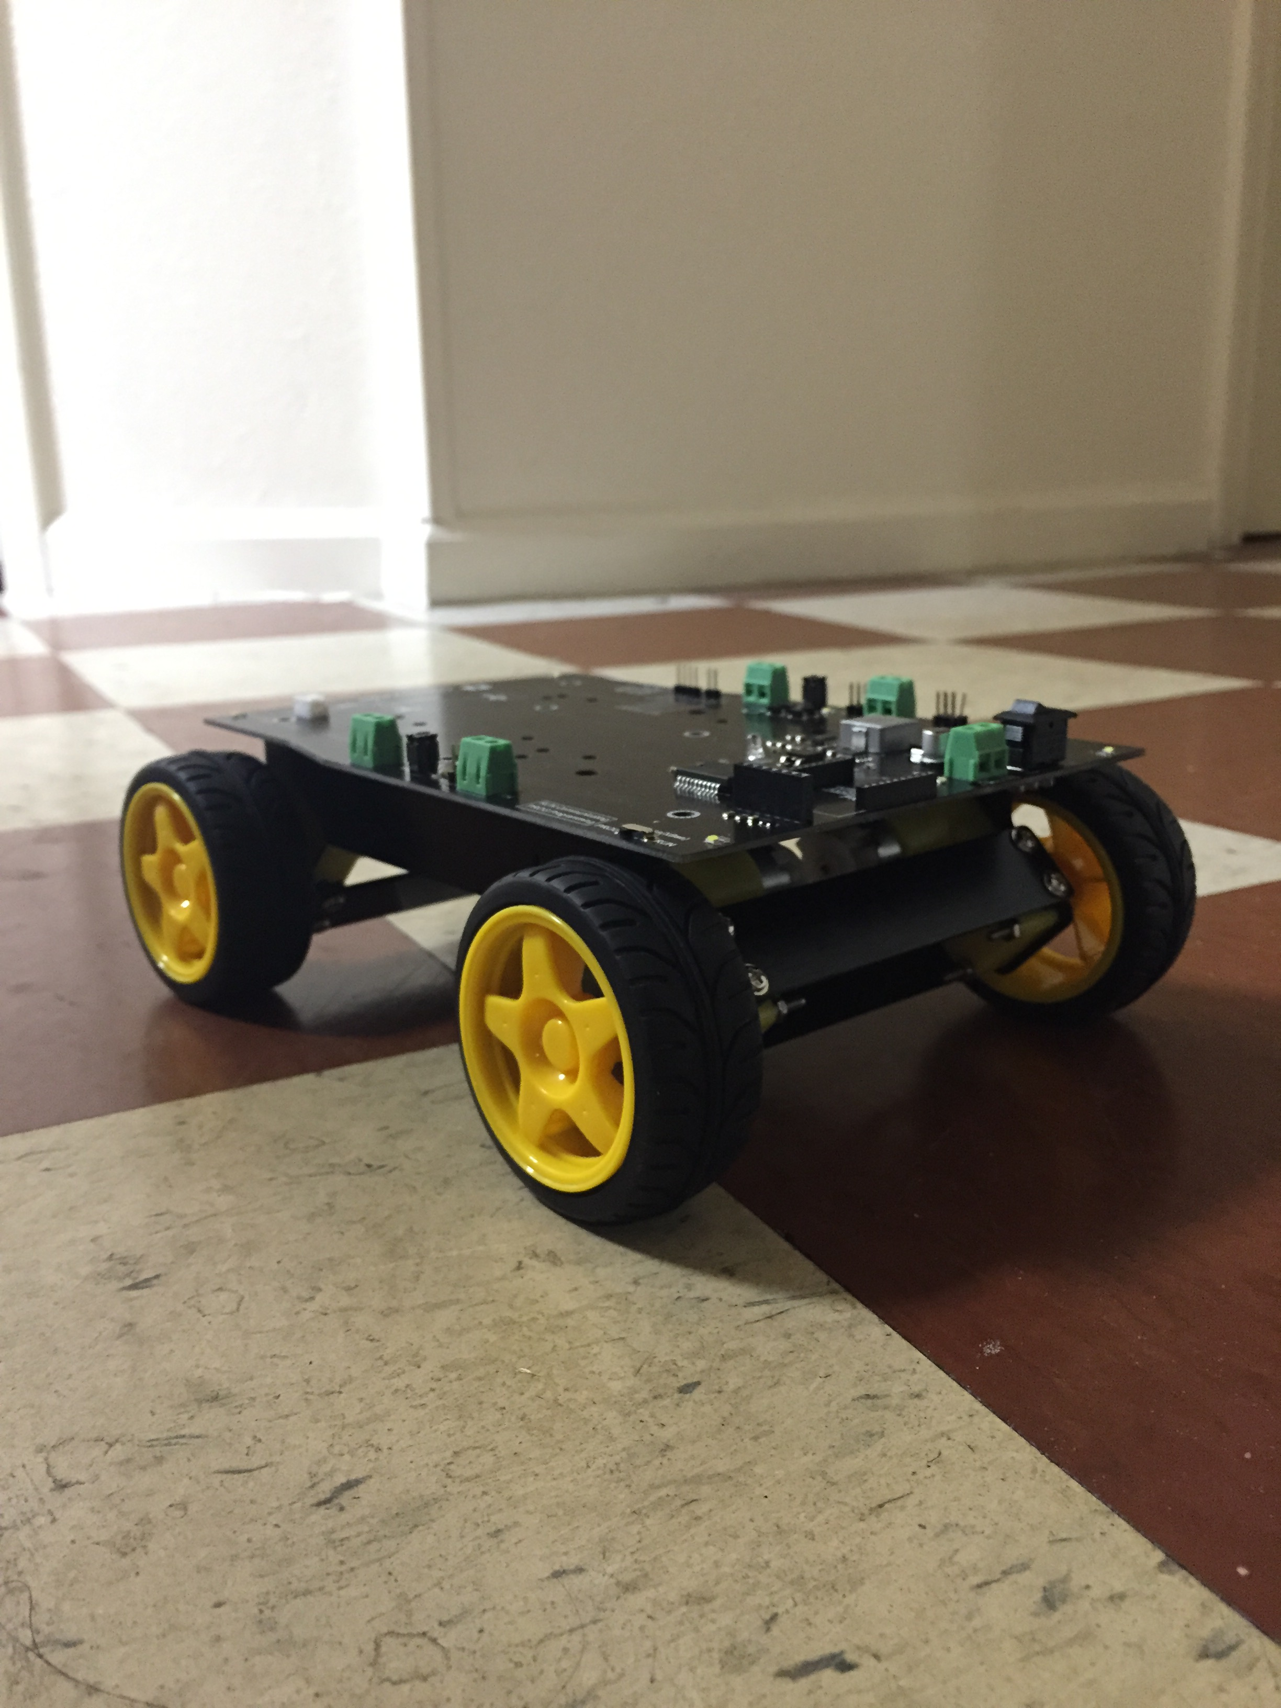
Component
ITEM | NUM | DESCRIPTION | REASON TO CHOOSE
Robot Body
Cherokey 4WD Mobile Robot | 1 | Embedded the L298P motor driver chip which allows to drive two 6-12V DC motors with maximum 2A current. Aluminum alloy body. | Come with 4 motors with motor driver. However, encoder is not included.
WiFi Module 4 | 1 |  | Used for provide WIFI access to Odroid.
Cooling Fan | 1 |  | Used to cooling the board
Encode | 2 | With hall sensors or laser sensors | To get the speed feedback for motors
Servo | 1 | HS-311 Standard | Used to rotate the camera
Battery | 1 |  | A battery of output of 7.4V is needed to power the Arduino, Odroid, 4 motors and the servo.

Slide 9
The End

