Slide 1
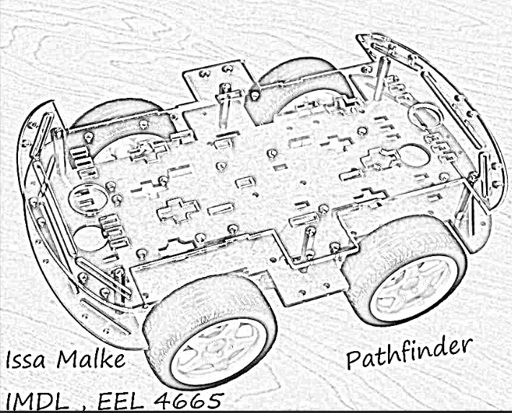
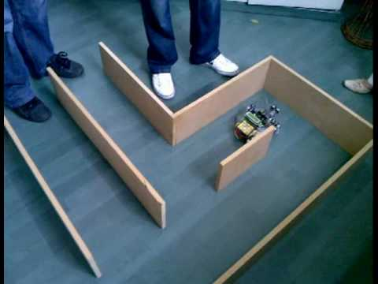

The name of the Robot reflects its duty which is find its way through obstacles, and map the path to follow it back to where it came from.

Slide 2
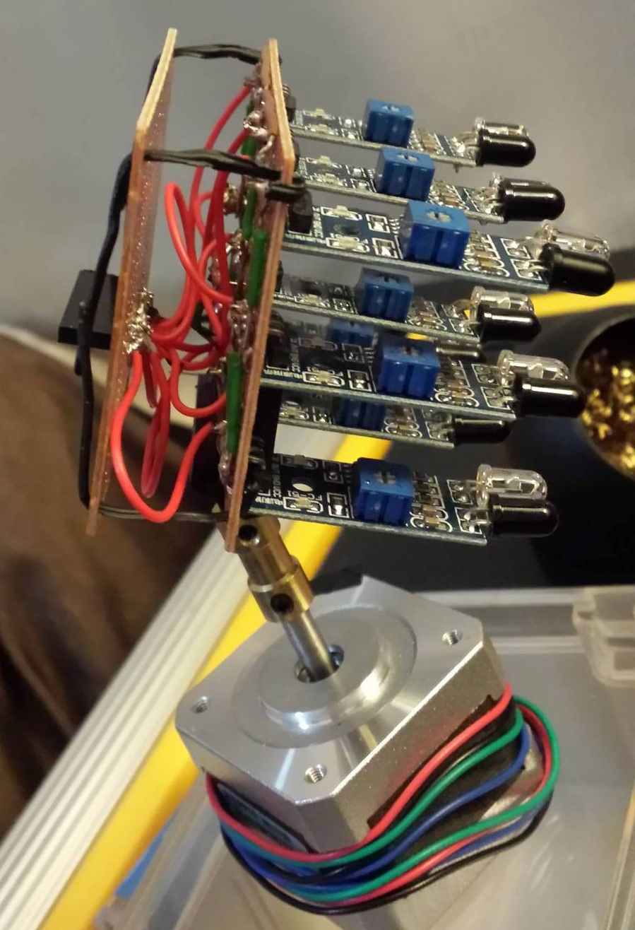
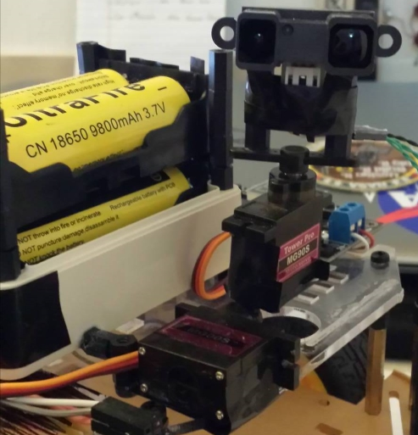
Plan A, 3 x 3 IR Matrix Sensor
Plan B, Long Range 3D IR Sensor
A special Sensor will be used “designed” for detecting obstacles. A 3 by 3 IR Matrix will be designed using 9 IR sensors, which has a range from 2 to 80 cm. Reduced to 30 cm to avoid interfering with other IR sensor.

Slide 3
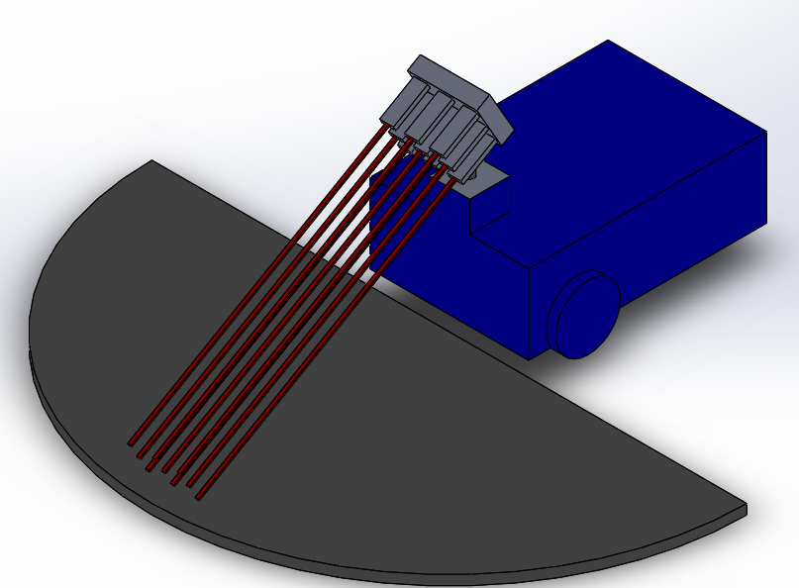
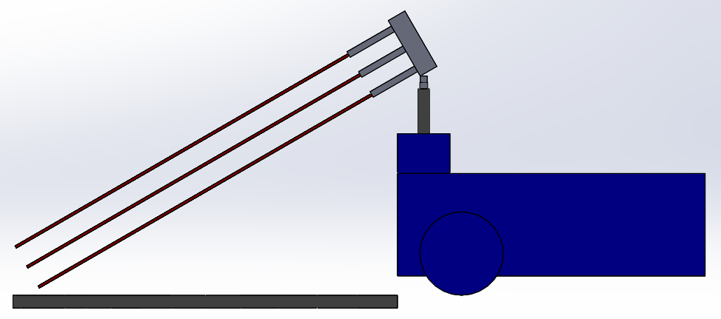
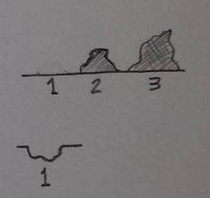

Slide 4
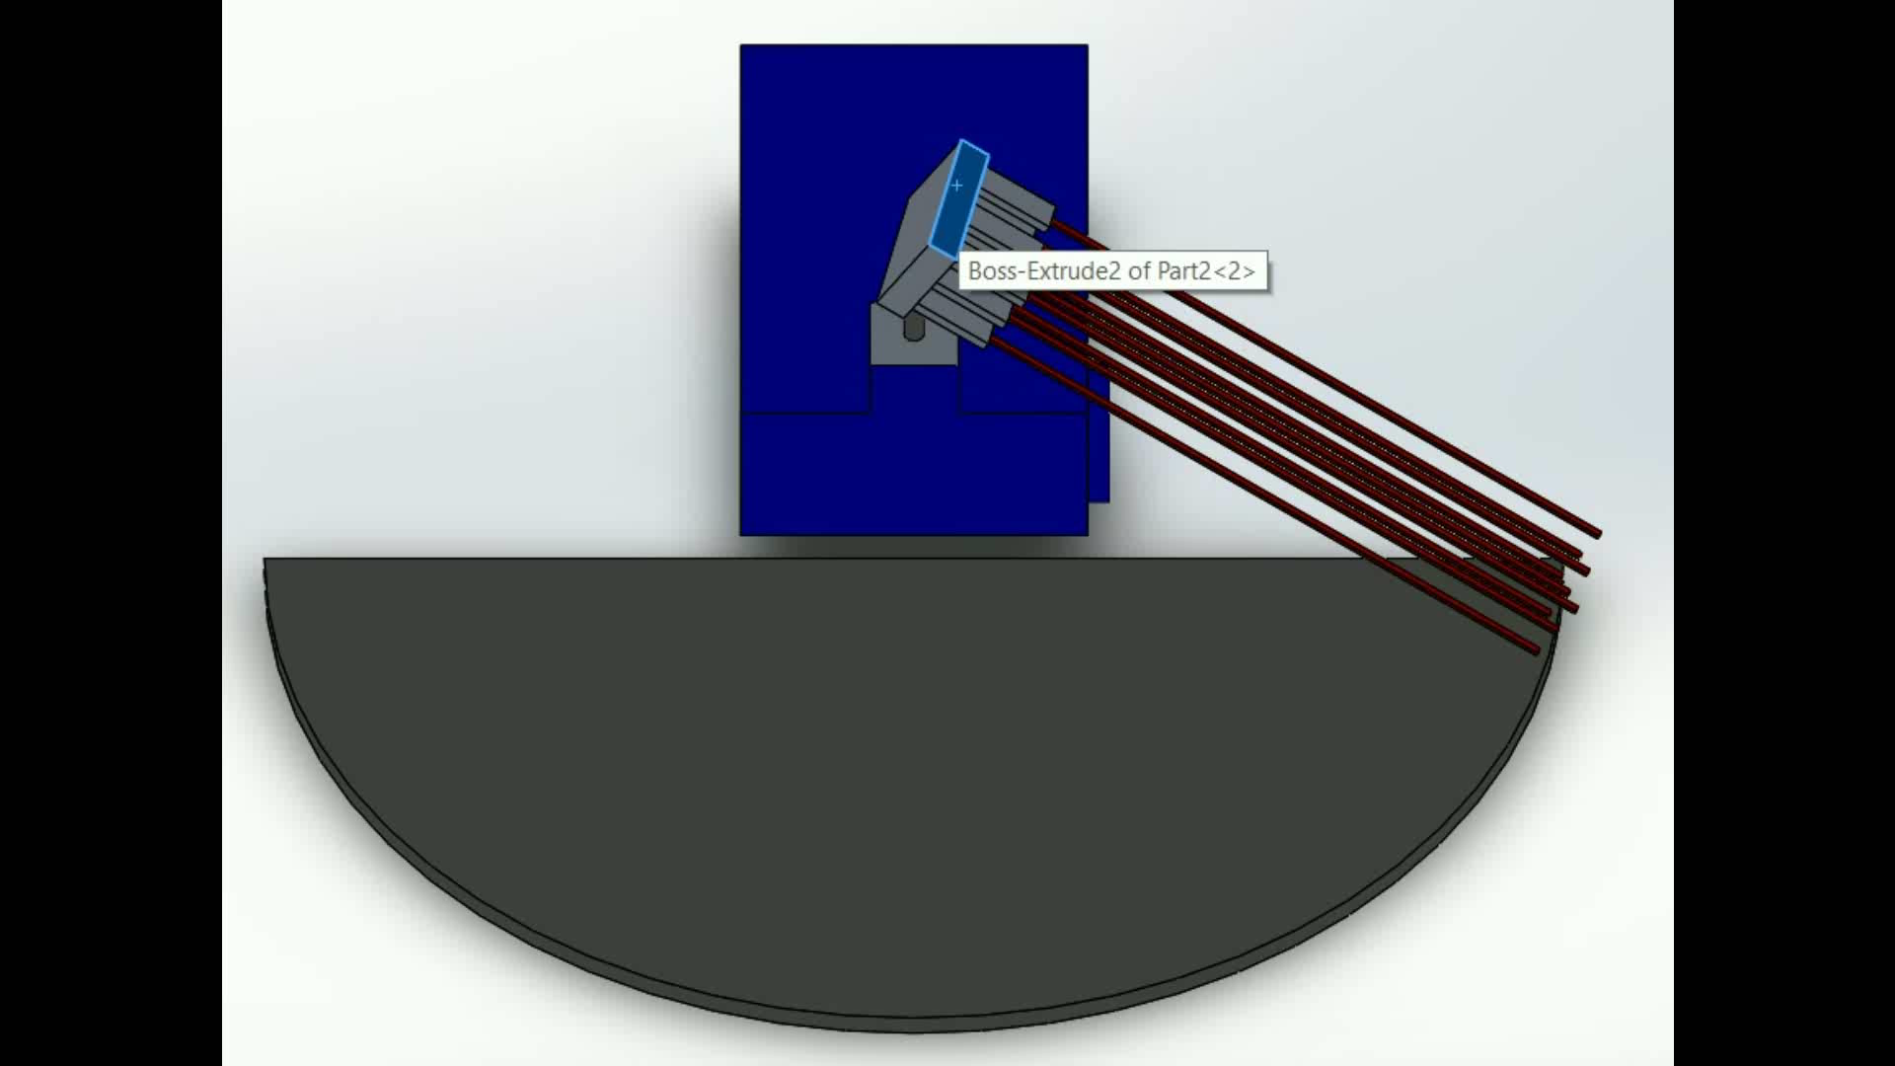

Slide 5
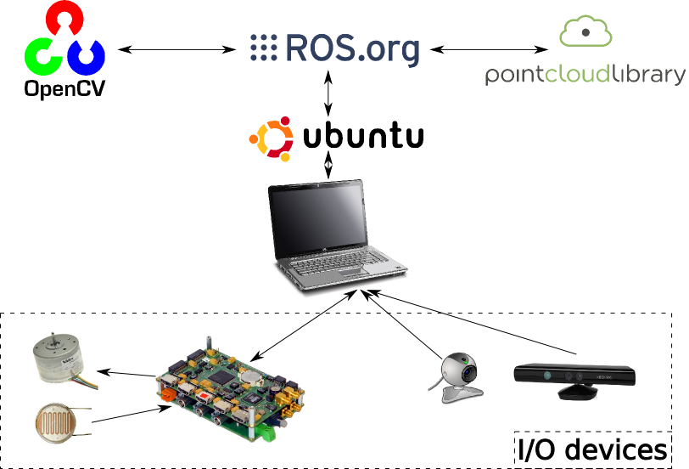
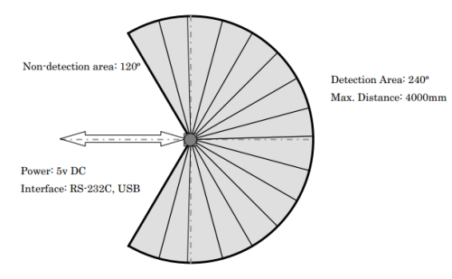
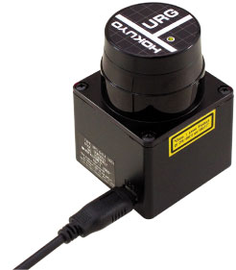
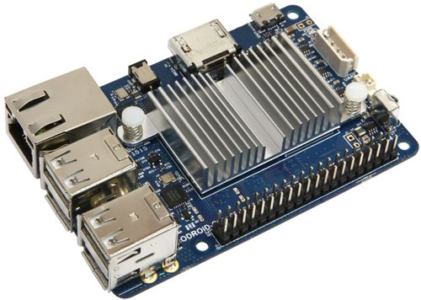
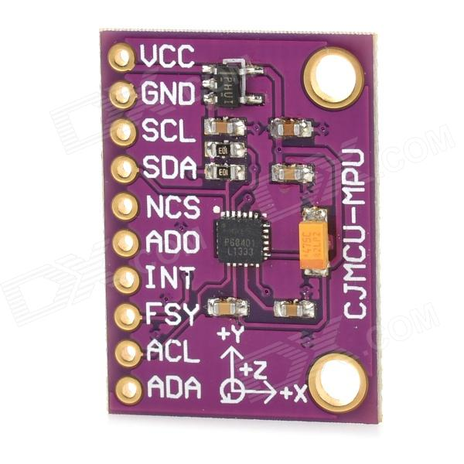
ROS provides standard operating system facilities such as hardware abstraction, low-level device control, implementation of commonly used functionalities, message passing between processes, and package management.

Slide 6
