Slide 1
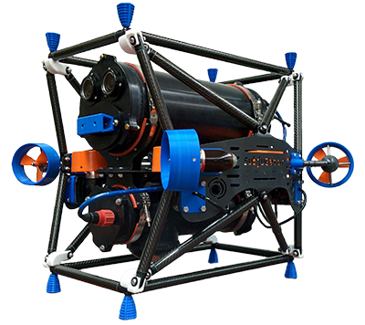
Subjugator

Slide 2
Subjugator
Perception: Stereo, monocular
State estimation: UKF using DVL, IMU, optical flow
Control: LQR
Motion Planning: RRT

Slide 3
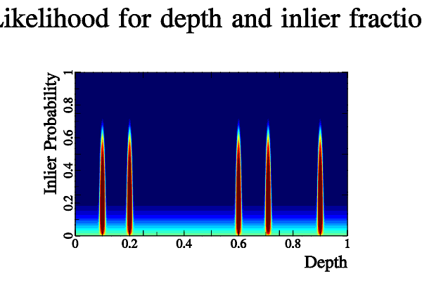
Outlier-Tolerant Depth Estimation

Slide 4
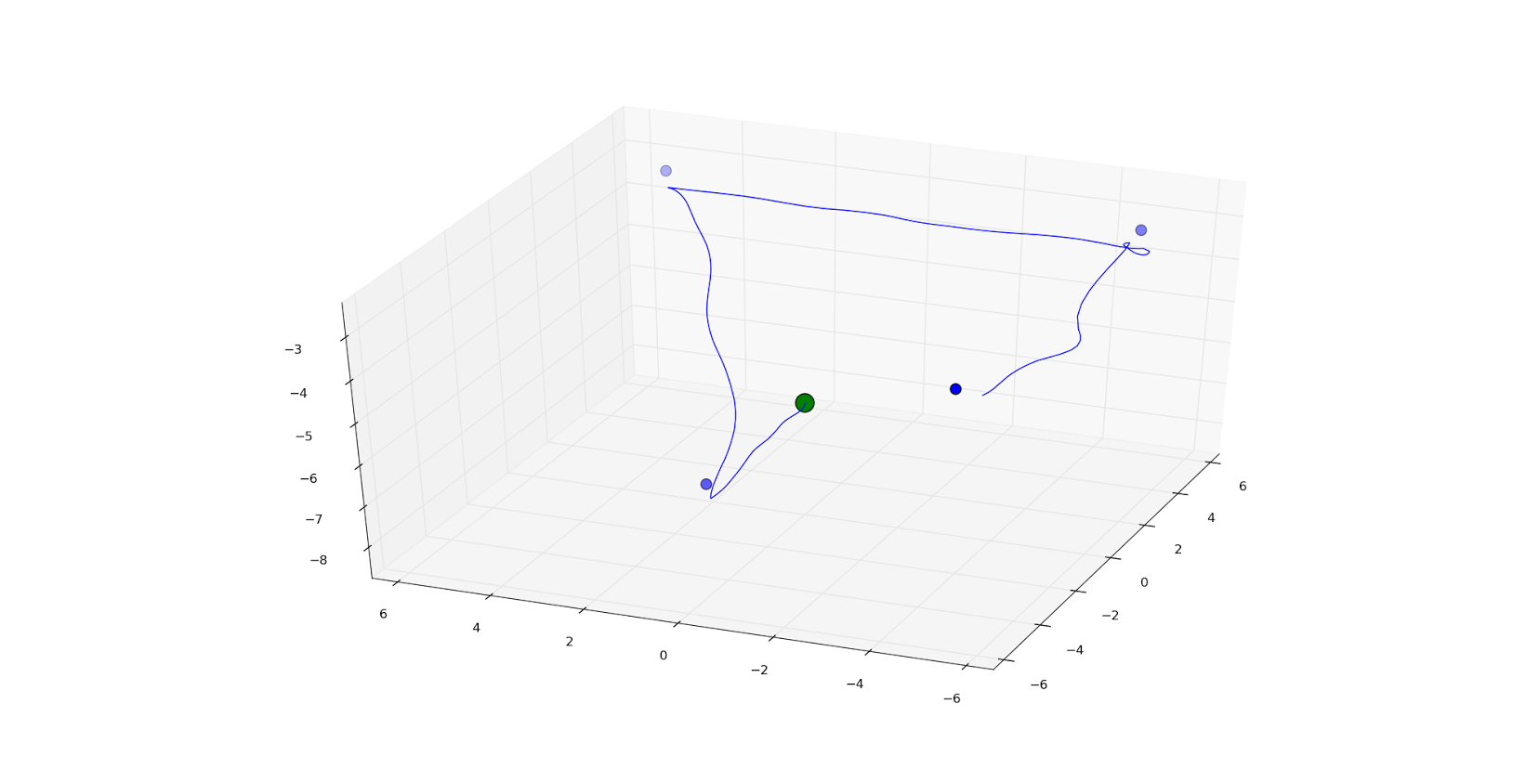
Simulated Waypoints

Slide 5
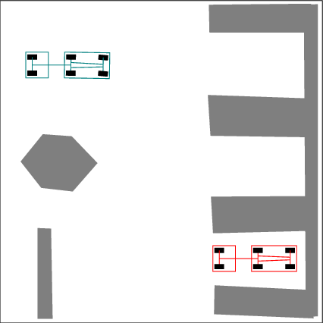
And parking a car with a trailer

Slide 6
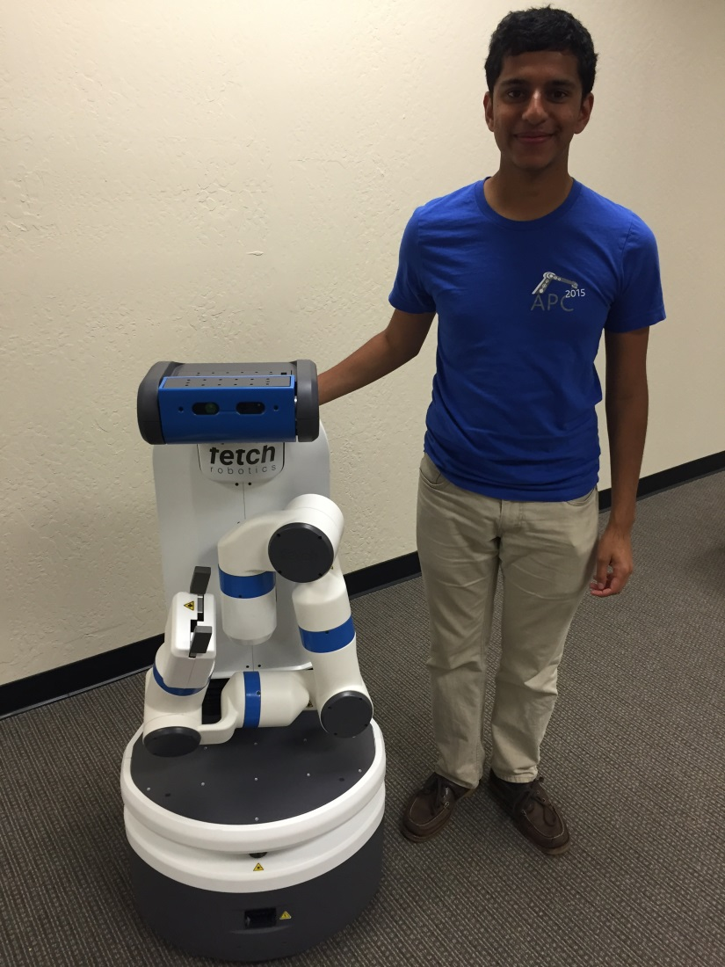
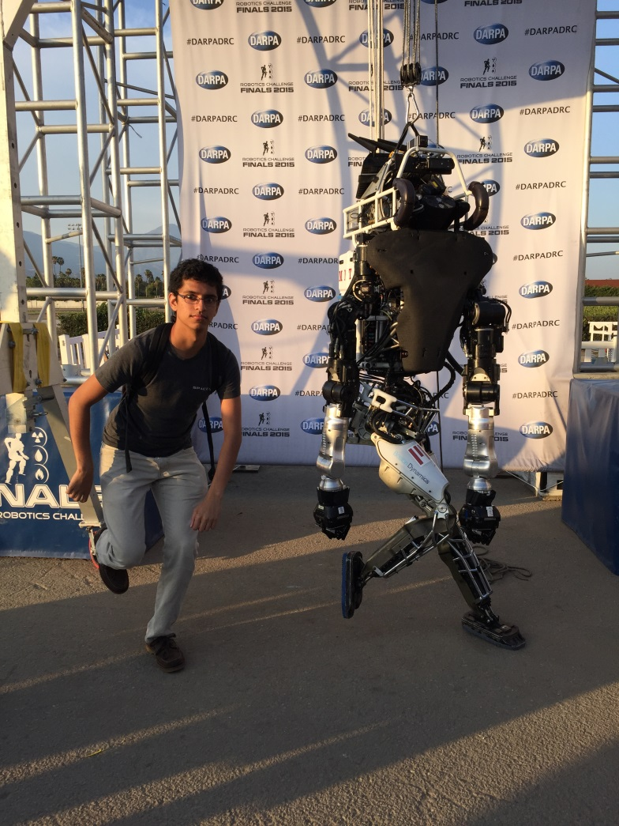
Modern robots

Slide 7
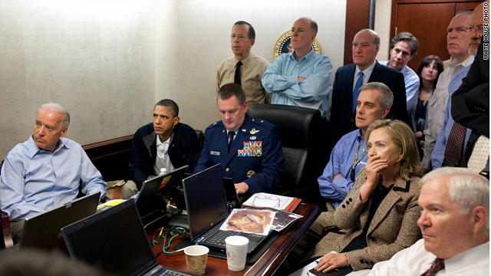
Spot the difference

