Slide 1
Rebounder
Amit Parikh
January 28th, 2016

Slide 2
Overview
Mission
Approach
Goals

Slide 3
Mission
To retrieve an object only after it has been determined that the object must be recovered
Return object to user or base station

Slide 4
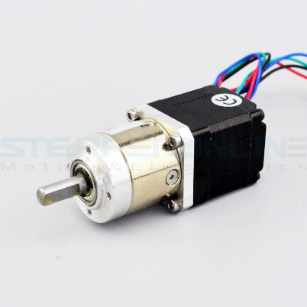
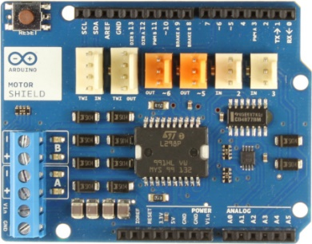
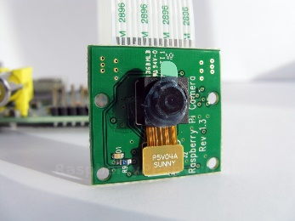
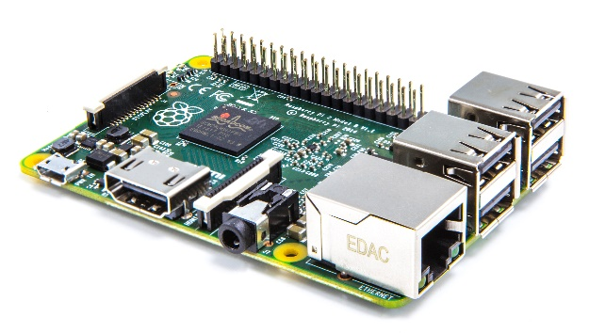
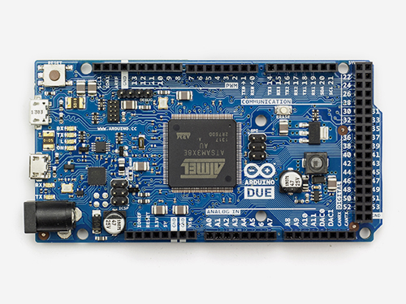
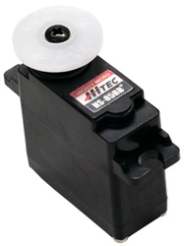
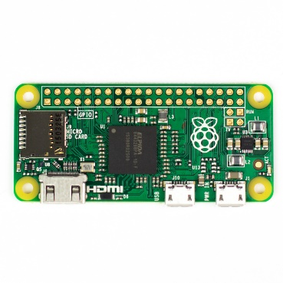
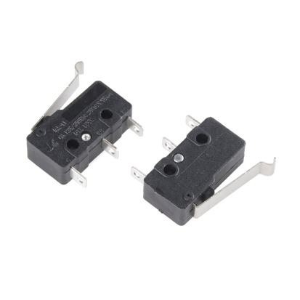
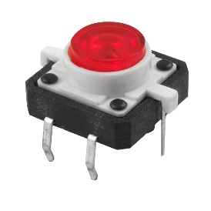
System Overview
Notes:
LED tactile button → Raspberry Pi Zero
Raspberry Pi Zero → Raspberry Pi 2 (via WiFi)
Camera → Raspberry Pi 2
Raspberry Pi 2 ←→Arduino Due
Arduino Due ←→Motor controller (not necessarily Arduino shield) ←→Stepper motor
Arduino Due → Servo (PWM)
Ultrasonic Rangefinder → Arduino Due (bi-directional TTL pulse interface)
SPDT switch → Arduino Due

Slide 5
Mobile Platform
Main platform
Secondary platform
Arm
Treads

Slide 6
Behaviors
Target detection
Obstacle avoidance
Idle mode

Slide 7
Questions?

