Slide 1
Robot Report
Vacuum Cleaner Robot (Stupid Dog)
Student name: Su Pu
Email: soupsoup88@ufl.edu
Instructors: Dr. A. Antonio Arroyo, Dr. Eric M. Schwartz
TAs: Andy Gray, Jake Easterling, Ralph F. Leyva
Date:11-Jan-28

Slide 2
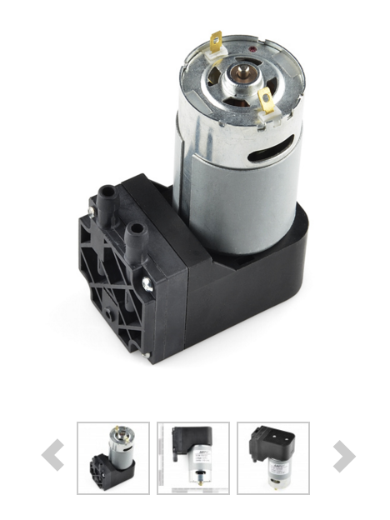
1. Arduino MEGA 2560 R3
2. Vacuum pump
Not expensive on the Sparkfun website, require 12V voltage, the process how to adjust the voltage should be take seriously.
3. Sensors
IR sensors (2)
Temperature sensor (1)
Bumper sensor (2)
4. Sound reception device and microphone
Speaker (1)
Ultrasonic transducer sensors (4)
5.Motor system
two motors with encoders
duel motor drive controller
two caster wheels
6. Battery

Slide 3
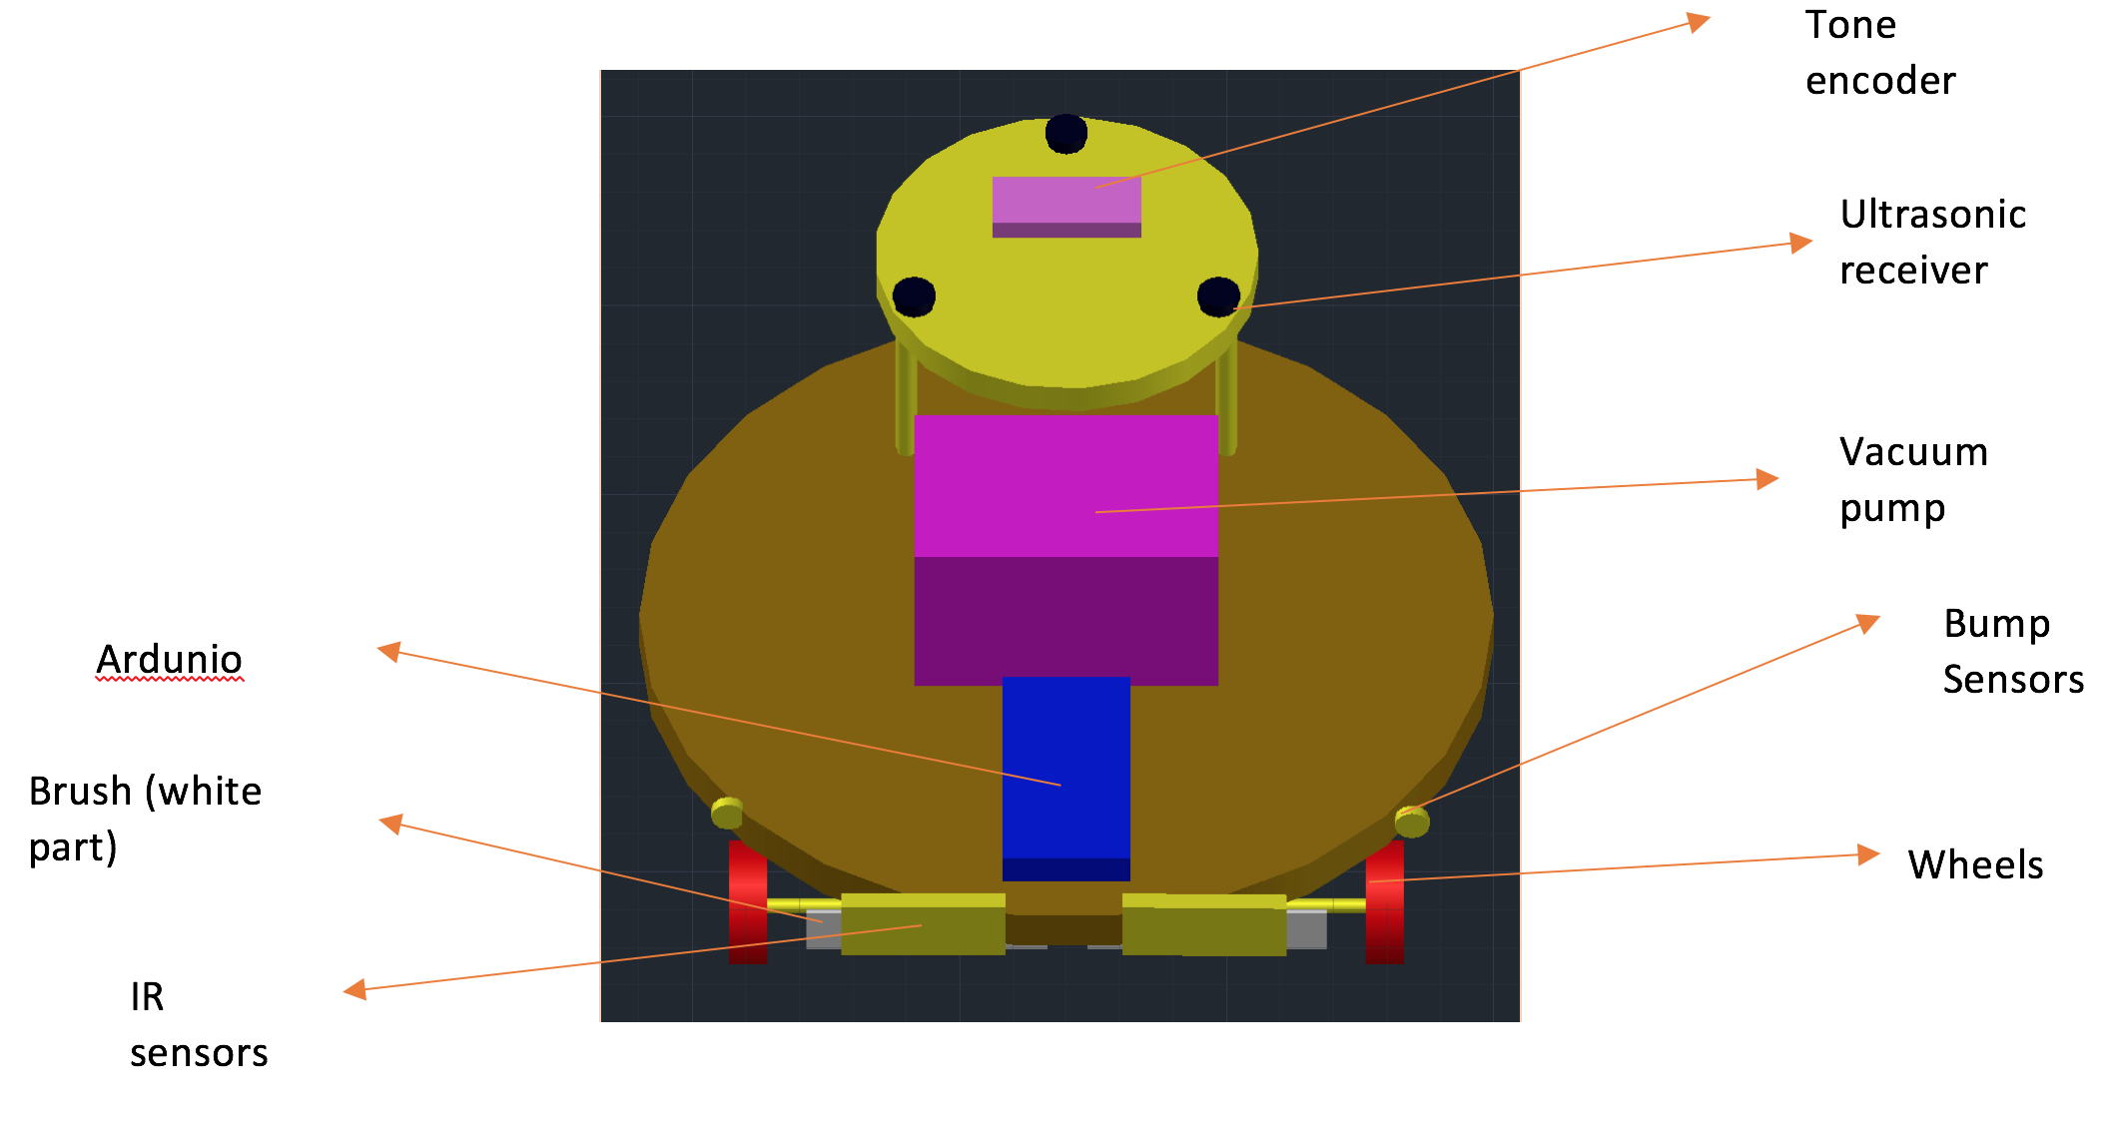

Slide 5
Questions?

Slide 6
Thank You

