Slide 1
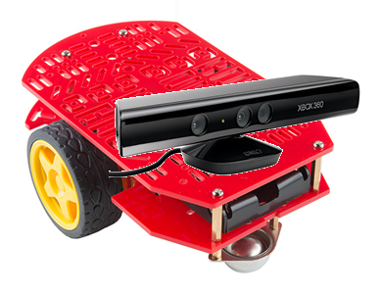
HAL IMDL Report
By Scott Siegel

Slide 2
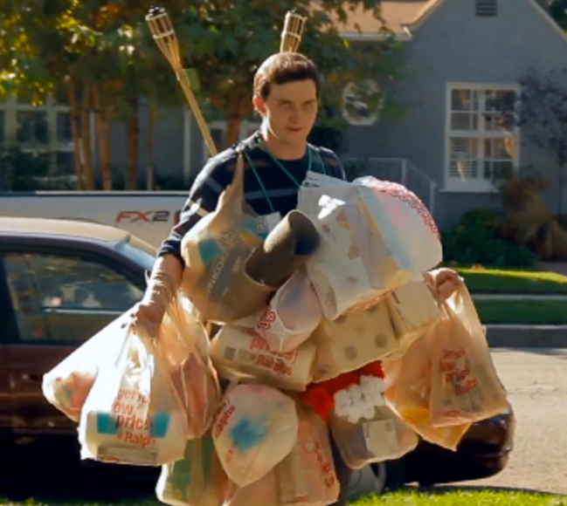
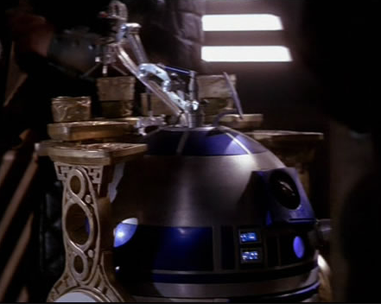
Concept
HAL will be a robot that uses the Kinect to following people.

Slide 3
Goals
Decide a pose or action to instruct the robot to begin following.
Continuously relay information from the Kinect to maintain original position in relation to person.
Avoid obstacles while following the person.
Personify HALL and make him lovable.

Slide 4
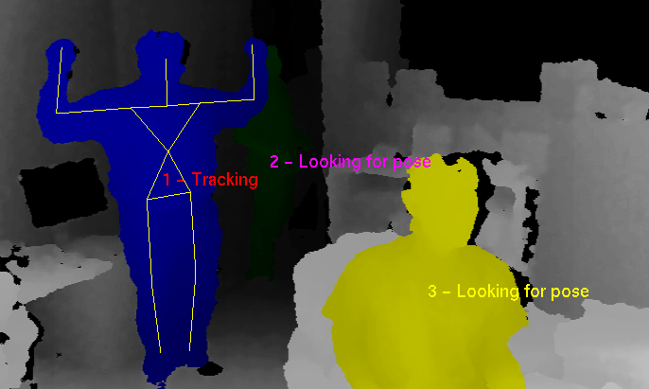
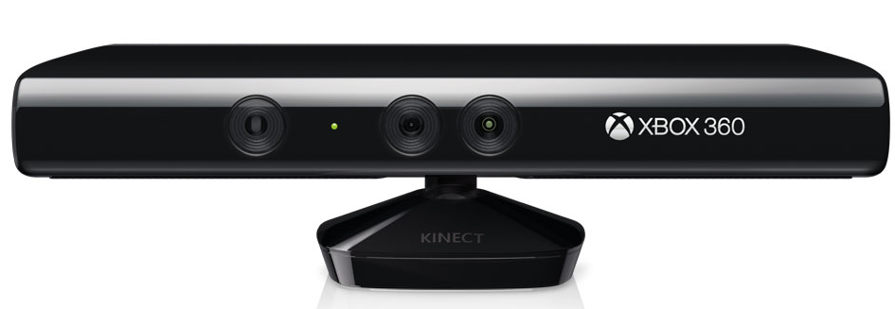
Hardware
Kinect – Using the Kinect will allow for the identification of certain poses and distance information about the skeletal nodes.

Slide 5
Hardware (Cont.)
Raspberry Pi 2 – This will enable the Kinect to communicate with the robot using the Robotic Operating System (ROS) library suite.
Router- Communicate with a Wifi receiver .
Laptop- Integrate information from Kinect.
Arduino Uno – Increase the number of digital and analog pins.
4 Sonar Sensors – Enable obstacle avoidance.
2 Brushed Motors W/ Shaft Encoders – Enable translational movement.
Speaker – Allow HAL to communicate with person being followed.

Slide 6
Questions?

