Slide 1
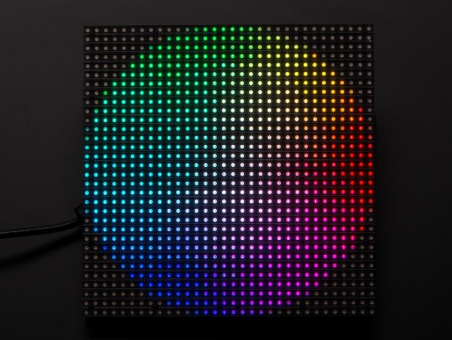
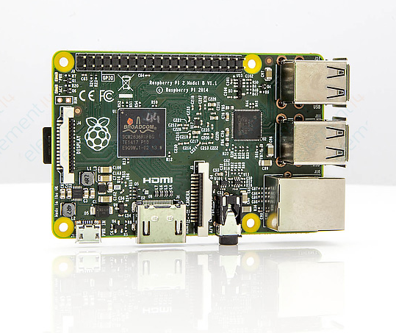
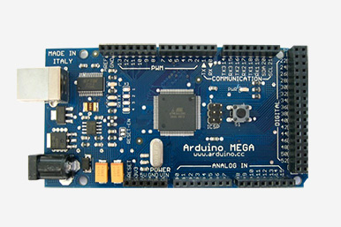
PB99
Geoff Turman

Slide 2
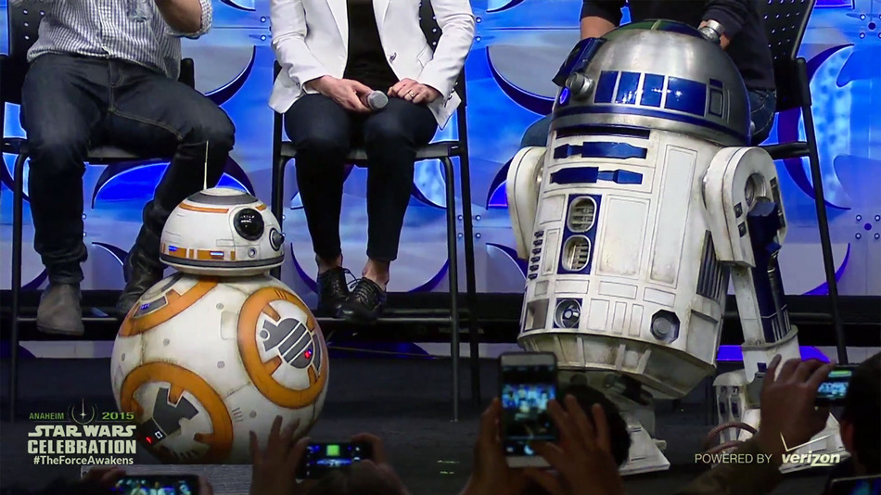
PB99?

Slide 3
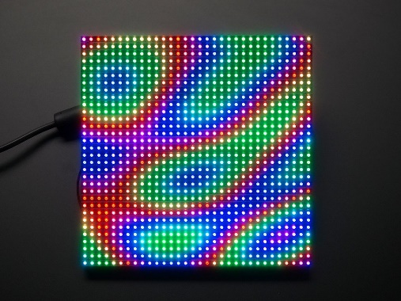
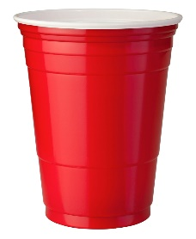
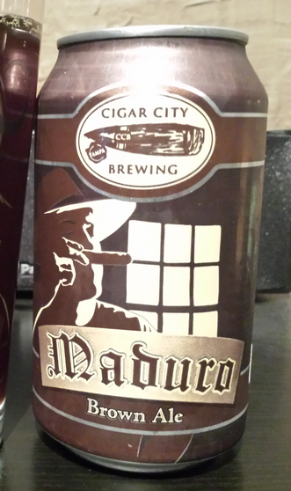
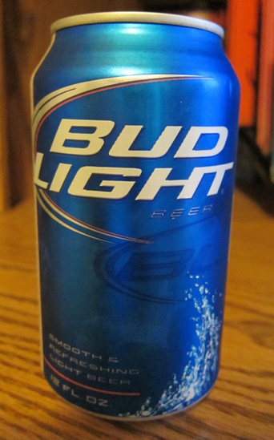
Purpose and behavior
Display emotion
Small and mobile, avoids obstacles
Displays a unique reaction after being shown one of three different “cups”
“Super awesome!!”
“OK.”
“Ew ☹”

Slide 4
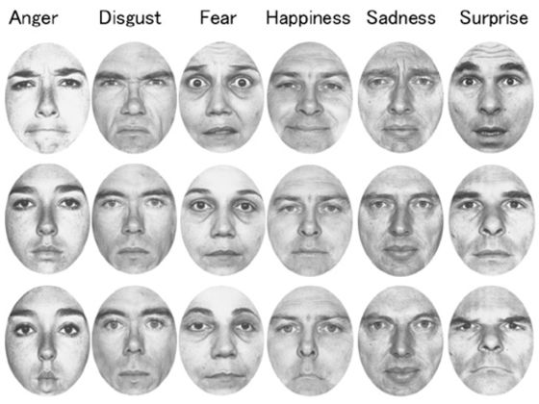
Displaying emotion
LED array
Blue = chill, green = disgust,
red = anger, etc
Moving head
Shows where PB’s attention is
Range and speed of movements
Fast = excited, slow = casual,
jitter = scared, etc

Slide 5
Structure
Layer to mount LED array
and camera
Layer for Raspberry Pi
Layer for Arduino and
motor controllers
Bottom chassis holds battery,
motors, switching regulators
and sensors

Slide 6
System design
Pi HAT
LiPo Battery
Vbatt
Pi cam
2xSwitching Regulators
5V
Accel/Gyro
Serial
Servo
I2C
Left IR
Right IR
Center IR
4xMotor controllers
ADC
PWM
4xMotors

Slide 7
Questions?
Parts list:
Arduino MEGA, Raspberry Pi 2
Adafruit LED array + Pi Hat
LiPo Battery
5V 5A switching regulator x2
Brushed motors x4
Servo motor (for head actuation)
Wheels + hubs x4
Base platform
Sensors
IR sensors x3 (left, forward, right)
Bump sensors x2 (back and front)
3 axis accelerometer / gyro

