Slide 1
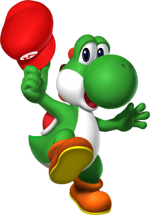
Team: Yoshi Squad Robot: Mariokart Team Members: Adam Sass Madalyn Sowada Sophia Ip
EGN 1935: ECE (Ad)Ventures

Slide 2
Adam Sass
Freshman
Electrical Engineering Major
Hands on experience is invaluable to an engineers education
Allow me to get more involved in other university projects
Receive a Bachelors in Electrical Engineering
Obtain internship by junior year, and have a stable job waiting for me after graduating
“Dedication, Determination, Dedication, & Desire : Four D’s of success”

Slide 3
Madalyn Sowada
2nd semester Freshman
Electrical Engineering Major
I learned that engineering can be fun!
I will have experience to draw on when I take courses later on.
I plan to graduate with a Bachelors Degree in Electrical Engineering and a Minor in Communications.
My career plans are still developing
Participate and have fun!

Slide 4
Sophia Ip
2nd semester Freshman
Computer Software Engineer
Gained the general idea of what’s ahead in this career. Learned about circuits and sensors.
Allows me to better prepare for my future in Computer Engineering.
UF plans is to graduate in 4 years and attend grad school
Career: Too soon to tell.
Words of Wisdom: Get involved outside of class; Pick the better functioning robot.

Slide 5
Robot Story
The Mariokart is on a quest to save Princess Peach from the Koop King himself, Bowser. In his journey, Mariokart must race to the princess and defeat foes along the way. Once Bowser is defeated, Mariokart rescues the princess and finally gets his cake.

Slide 6
Team Conclusions
We learned how to program an autonomous robot that was able to travel through a maze and stop when it reached the desired destination.
Attend class and pay attention because there is always something new to learn.

Slide 7
